Slide 1
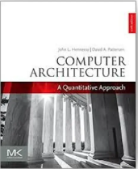
Computer Architecture
A Quantitative Approach, Sixth Edition
Chapter 1
Fundamentals of Quantitative Design and Analysis

Slide 2
Chapter 1
Read Chapter 1
Historical Perspective (1930s and 1940s)
  Appendix M.2 of H&P (6th ed.)
  Computers as we know them are roughly 70 years old
  The von Neumann machine model that underlies computer design is only partially von Neumann's
  Konrad Zuse says he had “the bad luck of being too early”?
  No one was able to successfully patent the idea of a stored-program computer, much to the dismay of Eckert and Mauchly
Notes:
J. Presper Eckert and John Mauchly
at the Moore School of the University of Pennsylvania
built the world’s first fully operational electronic general-purpose computer called ENIAC. (decimal machine)
funded by the U.S. Army and became operational during World War II, but not publicly disclosed until 1946
John von Neumann
was attracted to the ENIAC project in 1944
was given credit for a stored-program computer called EDVAC,
much to the dismay of Eckert and Mauchly, whose names were omitted
Konrad Zuse
special-purpose machines built by Konrad Zuse in Germany in the late 1930s and early 1940s
Zuse was the first to implement floating point,
His last machine (Z4) was electromechanical but, because of the war, was never completed.
(binary machine, Z3: first computer to have independently stored programs – punched tape)
Resumed in 1950 and built up to Z43
https://www.youtube.com/watch?v=wu3Zch5tcM0

Slide 3
Early development steps
Make input and output easier than wiring circuit boards and reading lights
Make programming easier by developing higher level programming languages, so that users did not need to use binary machine code instructions
First compilers in late 1950’s, for Fortran and Cobol
Develop storage devices

Slide 4
Later development steps
Faster
More storage
Cheaper
Networking and parallel computing
Better user interfaces
Ubiquitous applications
Development of standards

Slide 5
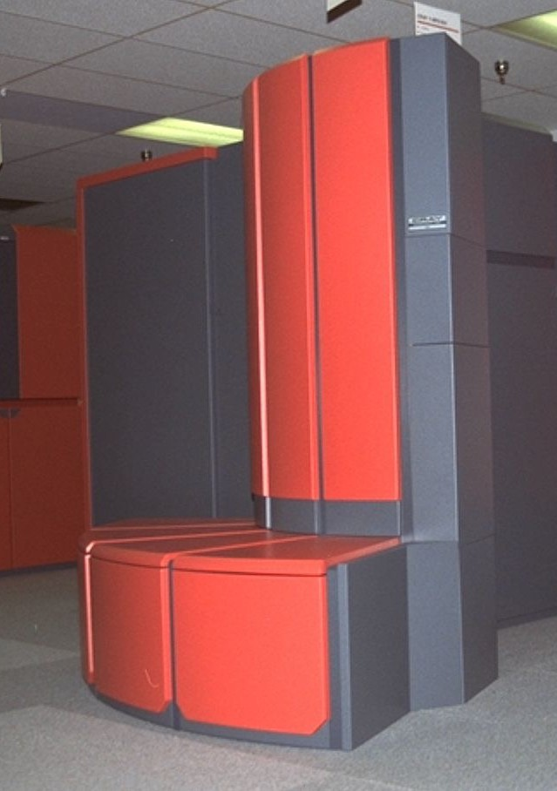
Perspective: An example
Most powerful supercomputer in 1988-9:
CRAY Y-MP
  8 vector processors (~0.3 GFlops each)
  32-bit registers, 512 MB SRAM
1993: a desktop workstation (IBM Power-2) matched its power at less than 10% of the cost
How did this happen?
  hardware improvements, e.g., squeezing more circuits into a smaller area
  improvements in instruction-set design, e.g., making the machine faster on a small number of frequently used instructions
  improvements in compilation, e.g., optimizing code to reduce memory accesses and make use of faster machine instructions
Cray Y-MP Model D
-from Wikipedia

Slide 6
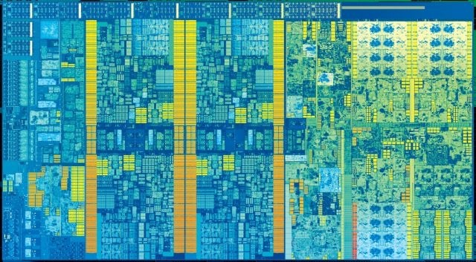
Perspective: An example (cont.)
2016-7: Intel Kaby Lake - Core i7
  4 cores (~60 GFlops each)
  64-bit registers
  8 MiB shared L3 cache
How did this happen?
  Even more hardware improvements, e.g., squeezing more circuits into a smaller area
  improvements in
  instruction- / thread- / data- level parallelism
» e.g., executing more instructions at the same time to improve performance
Lithography of Kabylake Core i7
-from https://en.wikichip.org

Slide 7
Computer Technology
Introduction
Performance improvements:
  Improvements in semiconductor technology
    Reduction in feature size (Moore’s Law: ~2x/2yrs)
    Increased clock speed
  Improvements in computer architectures
    Enabled by HLL compilers, UNIX
    Lead to RISC architectures (replacing VAX)
  Together have enabled:
    Lightweight computers
    Productivity-based managed / interpreted programming languages
Notes:
1.1
Improvements in semiconductor technology have historically
been characterized by a reduction in feature size,
enabling the number of transistors on a chip to
double approximately every two years (Moore's Law).
The development of high-level language (HLL) compilers
and the rise of the UNIX (vender independent) operating system
were pivotal in enabling the creation of RISC architectures (1980s).
HLL: high-level language compilers
VAX: virtual address extension
RISC: Reduced Instruction Set Computer (RISC) architecture

Slide 8
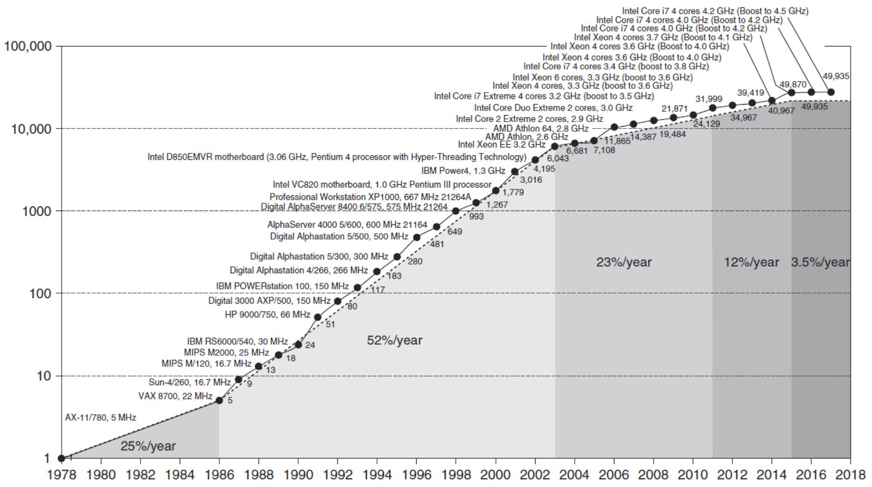
Single Processor Performance
Introduction
From Hennessy and Patterson, 6th edition
Performance (logarithmic)
VAX: 25%/year 1978 to 1986
RISC + x86: 52%/year 1986 to 2002
RISC + x86: 25%/year 2002 to 2010
Notes:
Figure 1.1 shows that the combination of architectural and organizational enhancements that led to a growth in processor performance over 40 years.
Prior to the mid-1980s, growth in processor performance was largely technology-driven and
averaged about 22% per year, or doubling performance every 3.5 years.
With the introduction of RISC architecture,
performance increased in growth to about 52% starting in 1986, or doubling every 2 years
Uniprocessor performance growth slowed to approximately 23% per year (doubling every 3.5 years)
between 2003 and 2011 due to power limitations (“Power Wall”)
from the end of Dennard scaling and the constraints of instruction-level parallelism
Dennard scaling: as transistors get smaller, their power density stays constant
From 2011 to 2015, the annual improvement was less than 12%, (doubling every 8 years)
in part due to the limitations of parallelism of Amdahl’s Law.
The end of Moore’s Law:
Since 2015 improvement has been just 3.5% per year or doubling every 20 years.

Slide 9
Conventional Wisdom in Comp. Arch
Old Conventional Wisdom: Power is free, Transistors are expensive
New Conventional Wisdom: “Power wall” Power expensive, transistors free (Can put more on chip than can afford to turn on)
Old CW: Sufficiently increasing Instruction Level Parallelism (ILP) via compilers, innovation (Out-of-order, speculation, VLIW, …)
New CW: “ILP wall” law of diminishing returns on more HW for ILP
Old CW: Multiplies are slow, Memory access is fast
New CW: “Memory wall” Memory slow, multiplies fast
(200 clock cycles to DRAM memory, 4 clocks for multiply)
Old CW: Uniprocessor performance 2X / 1.5 yrs
New CW: Power Wall + ILP Wall + Memory Wall = Brick Wall
– Uniprocessor performance now 2X / 5(?) yrs
⇒ Sea change in chip design: multiple “cores”
(2X processors per chip / ~ 2 years)
» Simpler processors are more power efficient
Notes:
ILP: Instruction level parallelism

Slide 10
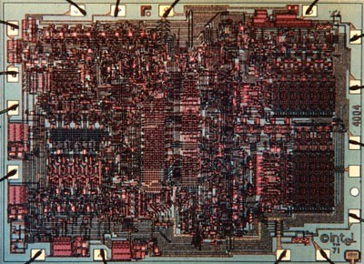
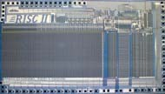
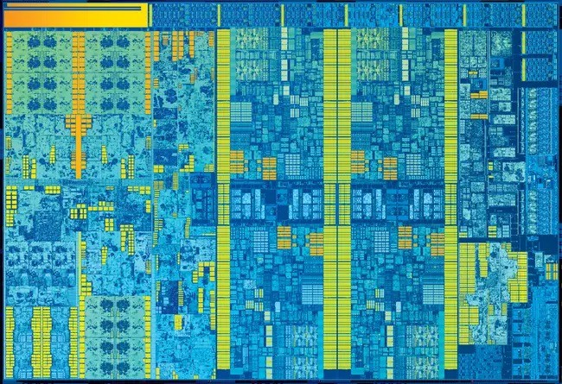
Sea Change in Chip Design
Intel 4004 (1971): 4-bit processor,
2312 transistors, 0.4 MHz,
10 micron PMOS, 11 mm² chip
RISC II (1983): 32-bit, 5 stage pipeline, 40,760 transistors, 3 MHz,
3 micron NMOS, 60 mm² chip
125 mm² chip, 0.065 micron CMOS (2006)
= 2312 RISC II + FPU + Icache + Dcache
  ~ 100M transistors
  RISC II shrinks to ~ 0.02 mm² at 65 nm
Skylake Core i7 (2015): 122 mm² chip is fabricated at 14nm
  ~ 1.7B transistors
Processor is the new transistor?
Notes:
Micron: micrometer
PMOS: p-channel metal-oxide-semiconductor
NMOS: N-type metal–oxide–semiconductor
CMOS: Complementary metal–oxide–semiconductor
2006:
A 125 mm² chip fabricated using 0.065 micron CMOS technology in 2006
was designed to integrate the functionality of the RISC II processor
along with a Floating-Point Unit (FPU), Instruction Cache (Icache), and Data Cache (Dcache).

Slide 11
Current Trends in Architecture
Introduction
Cannot continue to leverage Instruction-Level parallelism (ILP)
  Single processor performance improvement
  ended in 2003
Emergence of new models for performance:
  Data-level parallelism (DLP)
  Thread-level parallelism (TLP)
  Request-level parallelism (RLP)
These require explicit restructuring
of the application

Slide 12
Problems with Sea Change
Algorithms, Programming Languages, Compilers,
Operating Systems, Architectures, Libraries, …
  Not ready to supply Thread-Level Parallelism or Data-Level Parallelism for 1000 CPUs / chip
  Unlike Instruction-Level Parallelism, cannot be solved just by computer architects and compiler writers alone, but also cannot be solved without participation of computer architects
Shift in Parallelism
  GPU / Vector technologies for the shift from Instruction-Level Parallelism (ILP) to Thread-Level Parallelism (TLP) / Data-Level Parallelism (DLP)
Notes:
Shift to Thread and Data-Level Parallelism
The shift from instruction-level parallelism (ILP) to thread-level parallelism (TLP)
and data-level parallelism (DLP) has been driven by
the limitations of scaling ILP, particularly the stagnation of Moore's Law and
the increasing complexity of exploiting parallelism within a single CPU core.
GPUs and vector processors are the primary technologies enabling this shift.
GPUs, with their many-core architecture,
are designed for massive data-parallel computation,
excelling at performing the same operation on large datasets simultaneously.

Slide 13
Classes of Computers
Personal Mobile Device (PMD)
  e.g. start phones, tablet computers
  Emphasis on energy efficiency and real-time
Desktop Computing
  Emphasis on price-performance
Servers
  Emphasis on availability, scalability, throughput
Clusters / Warehouse Scale Computers
  Used for “Software as a Service (SaaS)”
  Emphasis on availability and price-performance
  Sub-class: Supercomputers, emphasis: floating-point performance and fast internal networks
Internet of Things / Embedded Computers
  Emphasis: price
Classes of Computers
Notes:
1.2
These changes have set the stage for a dramatic change in how we view
computing,
computing applications,
and the computer markets

Slide 14
Parallelism
Classes of Computers
Classes of parallelism in applications:
  Data-Level Parallelism (DLP)
  Task-Level Parallelism (TLP)
Classes of architectural parallelism:
  Instruction-Level Parallelism (ILP)
  Vector architectures / Graphic Processor Units (GPUs)
  Thread-Level Parallelism
  Request-Level Parallelism
Notes:
Parallelism is now the driving force of computer design,
with energy and cost being the primary constraints.
In terms of applications, there are two kinds of parallelism:
1. Data-level parallelism (DLP):
many data items operated on at the same time
2. Task-level parallelism (TLP):
multiple tasks operate independently in parallel
Computer hardware can exploit these two kinds of application parallelism in four major ways:
1. Instruction-level parallelism exploits data-level parallelism
at modest levels with compiler help using ideas like pipelining
and at medium levels using ideas like speculative execution.
2. Vector architectures, graphic processor units (GPUs),
and multimedia instruction sets exploit data-level parallelism
by applying a single instruction to a collection of data in parallel.
3. Thread-level parallelism exploits either data-level parallelism
or task-level parallelism in a tightly coupled hardware model
that allows for interaction between parallel threads.
4. Request-level parallelism exploits parallelism among largely decoupled tasks
specified by the programmer or the operating system.

Slide 15
Flynn’s Taxonomy
Single instruction stream, single data stream (SISD)
Single instruction stream, multiple data streams (SIMD)
  Vector architectures
  Multimedia extensions
  Graphics processor units
Multiple instruction streams, single data stream (MISD)
  No commercial implementation
Multiple instruction streams, multiple data streams (MIMD)
  Tightly-coupled MIMD
  Loosely-coupled MIMD
Classes of Computers
Notes:
In the 1960s, Michael J. Flynn found a simple parallel computing classification
that we still use today,
which targets data-level parallelism and task-level parallelism.
By analyzing the parallelism in the instruction and data streams
called for by the instructions at the most constrained component of the multiprocessor
all computers can be placed in one of four categories

Slide 16
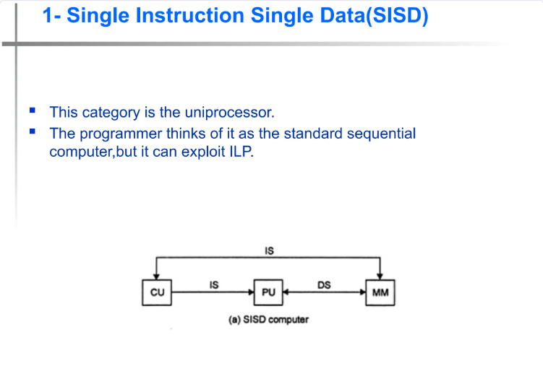

Notes:
Single instruction stream, single data stream (SISD)
This category is the uniprocessor.
The programmer thinks of it as the standard sequential computer, but it can exploit ILP.

Slide 17
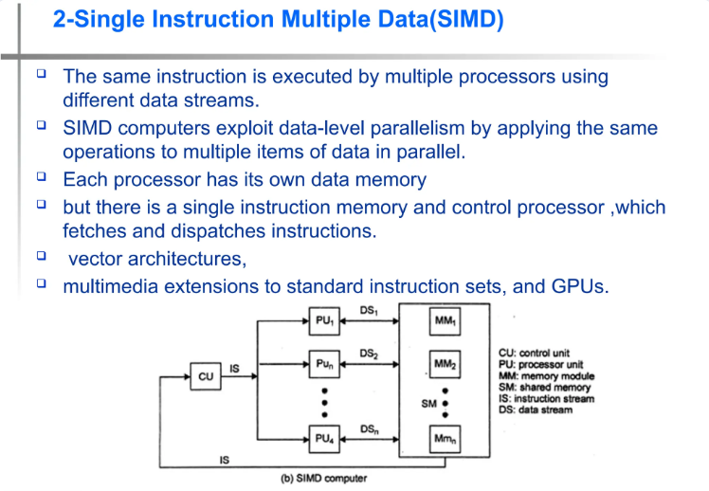
(Ch4)
Notes:
Single instruction stream, multiple data streams (SIMD)
The same instruction is executed by multiple processors using different data streams.
SIMD computers exploit data-level parallelism by applying the same operations to
multiple items of data in parallel.
Each processor has its own data memory
but there is a single instruction memory and control processor, which fetches and dispatches instructions
Examples:
vector architectures, multimedia extensions to standard instruction sets, and GPUs.

Slide 18
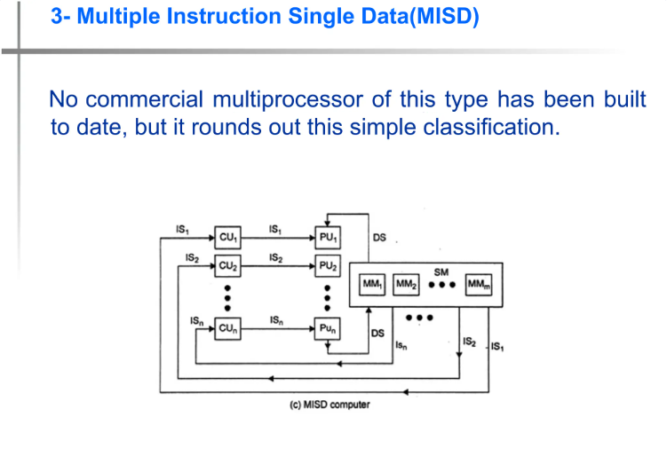
Notes:
Multiple instruction streams, single data stream (MISD)
No commercial multiprocessor of this type has been built to date,
but it rounds out this simple classification.

Slide 19
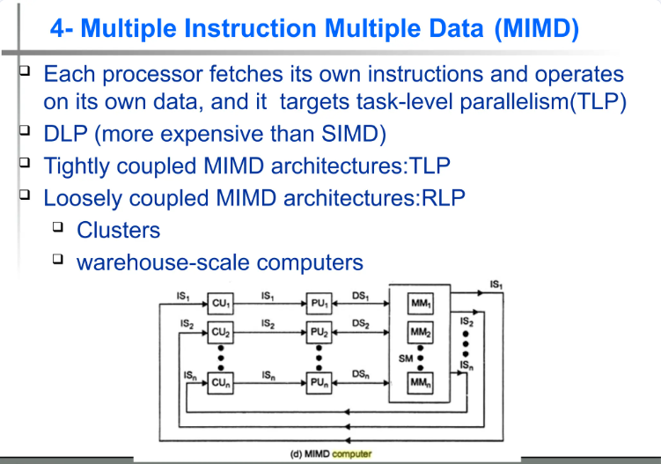
(Chapter 5)
(Chapter 6)
Notes:
Multiple instruction streams, multiple data streams (MIMD)
Each processor fetches its own instructions and operates on its own data,
and it targets task-level parallelism.
In general, MIMD is more flexible and more generally applicable,
but it is more expensive than SIMD.

Slide 20
Defining Computer Architecture
“Old” view of computer architecture:
  Instruction Set Architecture (ISA) design
  i.e. decisions regarding:
    registers, memory addressing, addressing modes, instruction operands, available operations, control flow instructions, instruction encoding
“Real” computer architecture:
  Specific requirements of the target machine
  Design to maximize performance within constraints: cost, power, and availability
  Includes ISA, microarchitecture, hardware
Defining Computer Architecture
Notes:
1.3
A few decades ago,
the term computer architecture generally referred to
only instruction set design and implementation.
Nowadays, the computer designer’s task is far more complex:
determine what attributes are important for a new computer,
then design a computer to maximize performance and energy efficiency
while staying within cost, power, and availability constraints.
There are many aspects to consider,
including instruction set design, microarchitecture, and hardware implementation.

Slide 21
INSTRUCTION SET ARCHITECTURE

Slide 22
Instruction Set Architecture: Critical Interface
software
instruction set
hardware
Properties of a good abstraction
Lasts through many generations (portability)
Used in many different ways (generality)
Provides convenient functionality to higher levels
Permits an efficient implementation at lower levels
Notes:
Instruction Set Architecture (ISA)
serves as the critical interface between software and hardware,
defining the set of instructions a processor can execute
and the capabilities it provides to programmers and compilers
A good ISA is considered a fundamental engineering abstraction
that enables hardware and software to evolve independently
Properties of a good abstraction:
Portability and compatibility across different implementations
Allows support for diverse applications and programming paradigms
Provides convenient functionality to higher levels of the system
(e.g. operating systems and compilers)
Permits an efficient implementation at the lower levels of the system

Slide 23
Instruction Set Architecture
Register | Name | Use | Saver
x0 | zero | constant 0 | n/a
x1 | ra | return addr | caller
x2 | sp | stack ptr | callee
x3 | gp | global ptr
x4 | tp | thread ptr
x5-x7 | t0-t2 | temporaries | caller
x8 | s0/fp | saved/ frame ptr | callee
x9 | s1 | saved | callee
x10-x17 | a0-a7 | arguments | caller
x18-x27 | s2-s11 | saved | callee
x28-x31 | t3-t6 | temporaries | caller
f0-f7 | ft0-ft7 | FP temps | caller
f8-f9 | fs0-fs1 | FP saved | callee
f10-f17 | fa0-fa7 | FP arguments | callee
f18-f27 | fs2-fs21 | FP saved | callee
f28-f31 | ft8-ft11 | FP temps | caller
Class of ISA
  General-purpose registers architecture
  Register-memory
  vs. load-store
80x86 registers
  16 g.p., 16 f.p.
  Register-memory ISA
RISC-V registers
  32 g.p., 32 f.p.
  Load-store ISA
Defining Computer Architecture
Notes:
ISA: instruction set architecture
Class of ISA
Nearly all ISAs today are classified as general-purpose register architectures,
where the operands are either registers or memory locations.
RISC: reduced instruction set computer
RISC-V: “risk-five” is an open standard ISA based on RISC principles
modern RISC instruction set developed at the University of California, Berkeley,
made free and openly adoptable in response to industry demands
80x86 has
16 general-purpose registers and
16 that can hold floating-point data
RISC-V has
32 general-purpose and
32 floating-point registers
(see Figure 1.4)
register-memory ISAs:
an access memory as part of many instructions (80x86)
load-store ISAs:
can access memory only with load or store instructions (ARMv8 and RISC-V)

Slide 24
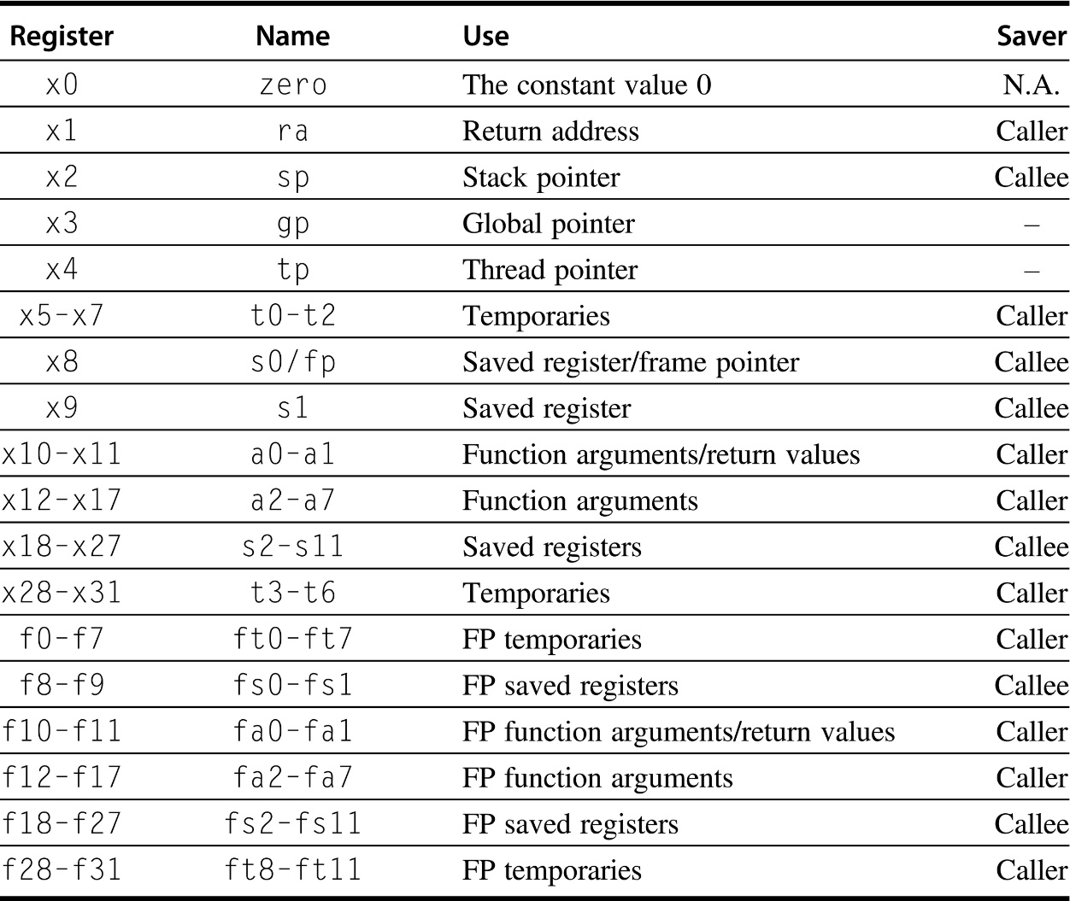
RISC-V ISA
Figure 1.4 RISC-V registers, names, usage, and calling conventions. In addition to the 32 general-purpose registers (x0–x31), RISC-V has 32 floating-point registers (f0–f31) that can hold either a 32-bit single-precision number or a 64-bit double-precision number. The registers that are preserved across a procedure call are labeled “Callee” saved.
Notes:
We will use MIPS32/MIPS64 ISA.
ISA: instruction set architecture
RISC: reduced instruction set computer
RISC-V: “risk-five” is an open standard ISA based on RISC principles

Slide 25
RISC-V ISA
Memory addressing
  RISC-V: byte addressed, aligned accesses faster
Addressing modes
  RISC-V: Register, immediate,
  displacement (base + offset)
  Other examples: autoincrement, indexed, PC-relative
Types and size of operands
  RISC-V: 8-bit, 32-bit, 64-bit
  IEEE 754 floating point 32-bit (single precision) and 64-bit (double precision).
  The 80x86 also supports 80-bit floating point (extended double precision).
Defining Computer Architecture
Notes:
Memory addressing
Virtually all systems (80x86, ARMv8, and RISC-V) use byte addressing to access memory operands.
ARMv8 requires that objects must be aligned.
The 80x86 and RISC-V do not require alignment,
but accesses are generally faster if operands are aligned.
Addressing modes
Addressing modes specify the address of a memory object.
RISC-V addressing modes are Register, Immediate (for constants), and Displacement,
(constant offset is added to a register to form the memory address)
Types and sizes of operands
Most ISAs (80x86, ARMv8, and RISC-V) support operand sizes of
8-bit (ASCII character)
16-bit (Unicode character or half word)
32-bit (integer or word)
64-bit (double word or long integer)
IEEE 754 floating point in 32-bit (single precision)
64-bit (double precision)
The 80x86 also supports 80-bit floating point (extended double precision).

Slide 26
Instruction Set Architecture
Operations
  RISC-V: data transfer, arithmetic, logical, control, floating point
  See Fig. 1.5 and Fig. 1.6 in text
Control flow instructions
  Use content of registers (RISC-V)
  vs. status bits (x86, ARMv7, ARMv8)
  Return address in register (RISC-V, ARMv7, ARMv8) vs. on stack (x86)
Encoding
  Fixed (RISC-V, ARMv7/v8 except compact
  instruction set) vs. variable length (x86)
Defining Computer Architecture
Notes:
Operations
The general categories of operations are data transfer, arithmetic logical,, and floating point.
(Refer to the next two slides.)
Control flow instructions
Virtually all ISAs support conditional branches, unconditional jumps, procedure calls, and returns
PC-relative addressing: branch address is specified by an address field that is added to the PC.
RISC-V conditional branches (BE, BNE, etc.) test the contents of registers
80x86 and ARMv8 branches test condition code bits set by arithmetic / logic operations
ARMv8 and RISC-V procedure call places the return address in a register
80x86 call places the return address on a stack in memory
Encoding an ISA (fixed or variable length)
ARMv8 and RISC-V instructions are (fixed length) 32 bits long
Advantage: simplifies instruction decoding
(Refer to slide 29)
80x86 encoding is variable length.
Advantage: can take less space than fixed-length instructions resulting in small program size.

Slide 27
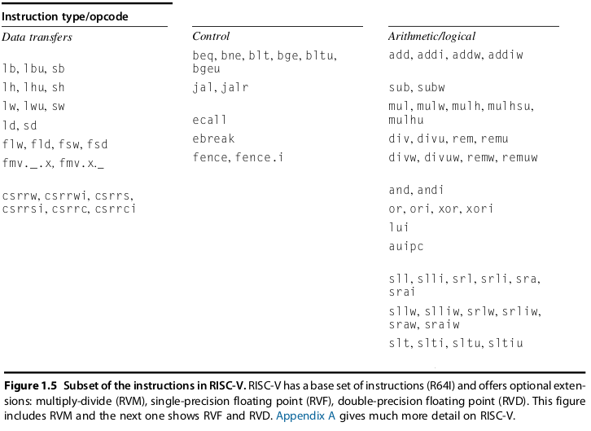
Instructions for RISC-V
Notes:
Operations
The general categories of operations are data transfer, arithmetic logical,, and floating point.
(Refer to the next two slides.)

Slide 28
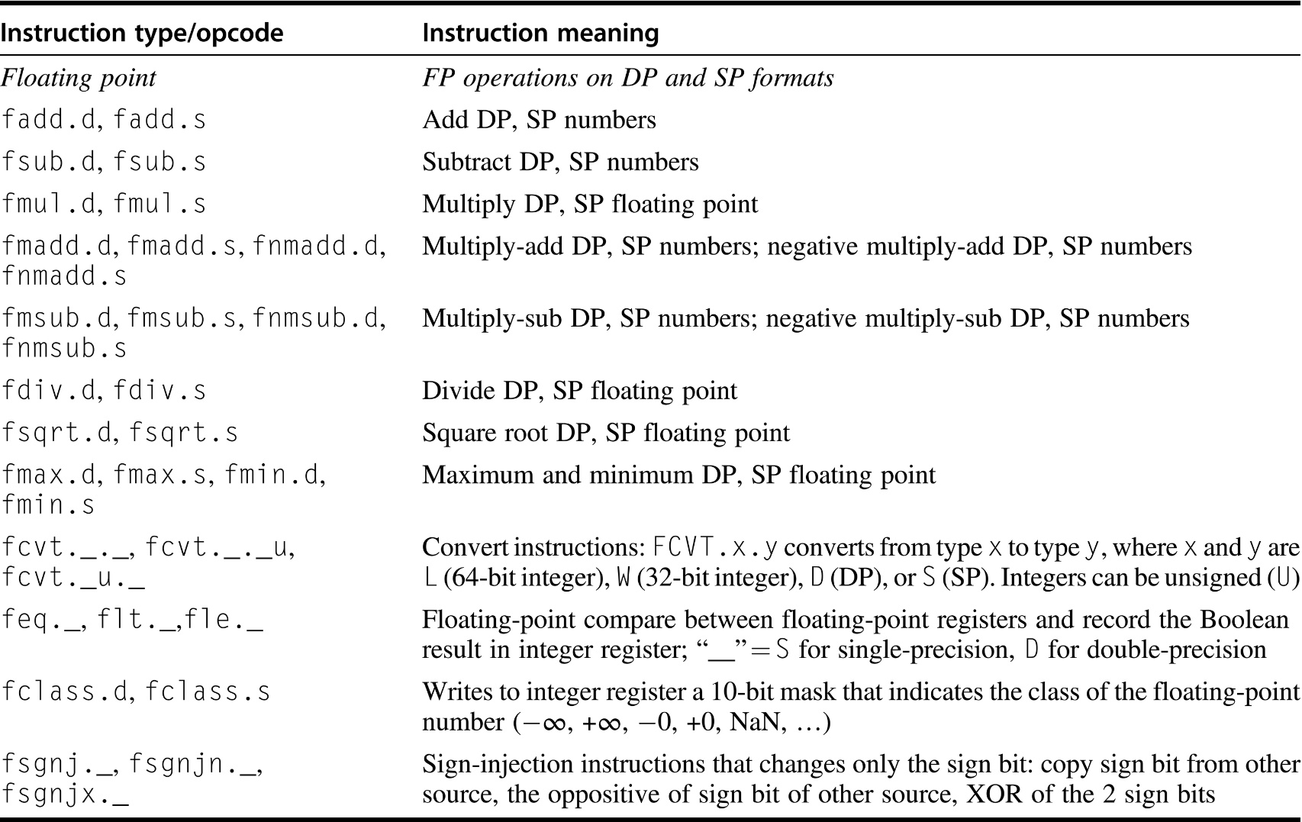
Floating point instructions for RISC-V
Figure 1.6 Floating point instructions for RISC-V. RISC-V has a base set of instructions (R64I) and offers optional extensions for single-precision floating point (RVF) and double-precision floating point (RVD). SP = single precision; DP = double precision.
Notes:
Operations
The general categories of operations are data transfer, arithmetic logical,, and floating point.
(Refer to the next two slides.)

Slide 29
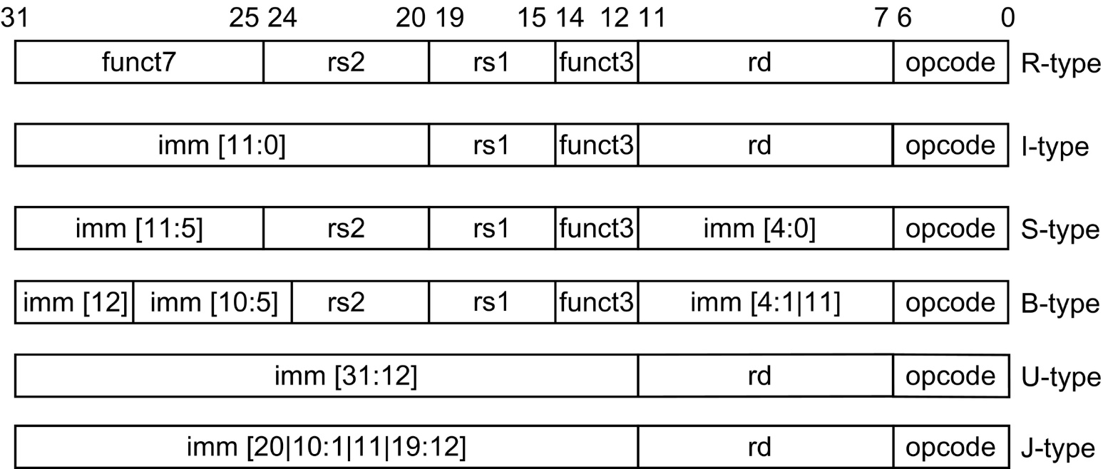
Encoding: RISC-V ISA
Figure 1.7 The base RISC-V instruction set architecture formats. All instructions are 32 bits long. The R format is for integer register-to-register operations, such as ADD, SUB, and so on. The I format is for loads and immediate operations, such as LD and ADDI. The B format is for branches, and the J format is for jumps and link. The S format is for stores. Having a separate format for stores allows the three register specifiers (rd, rs1, rs2) to always be in the same location in all formats. The U format is for the wide immediate instructions (LUI, AUIPC).
Notes:
Encoding an ISA (fixed or variable length)
ARMv8 and RISC-V instructions are (fixed length) 32 bits long
Advantage: simplifies instruction decoding
(Refer to slide 29)
80x86 encoding is variable length.
Advantage: can take less space than fixed-length instructions resulting in small program size.

Slide 30
Example: MIPS R3000 (June 1988)
r0 r1
°
°
°
Programmable storage
32-bit machine: 2³² x bytes
x 32-bit GPRs (R0=0)
x 32-bit FP regs (paired DP) HI, LO, PC
Data types ?
32-bit words
16-bit halfwords
8-bit bytes
Format ?
R-type, I-type, J-type,
FR, FI
Addressing Modes ?
the base register plus
a 16-bit signed displacement
0
R31 (ra)
PC
lo hi
Arithmetic logical
Add, AddU, Sub, SubU, And, Or, Xor, Nor, SLT, SLTU, AddI, AddIU, SLTI, SLTIU, AndI, OrI, XorI, LUI
SLL, SRL, SRA, SLLV, SRLV, SRAV
Memory Access
LB, LBU, LH, LHU, LW, LWL,LWR SB, SH, SW, SWL, SWR
Control
J, JAL, JR, JALR
BEQ, BNE, BLEZ,BGTZ,BLTZ,BGEZ,BLTZAL,BGEZAL
32-bit instructions on word boundary
Notes:
We will use MIPS32/MIPS64 ISA.
MIPS: Microprocessor without Interlocked Pipeline Stages
The MIPS ISA is a family of RISC architectures.
RISC: reduced instruction set computer
R3000 is a 32-bit RISC microprocessor chipset
developed by MIPS Computer Systems
that implemented the MIPS I instruction set architecture (ISA)
GPR: general purpose registers
HI and LO: used to hold the results of multiplication and division operation
LUI: load upper immediate
SLL: shift left logical
SRL: shift right logical
BLEZ: branch on less than or equal to zero

Slide 31
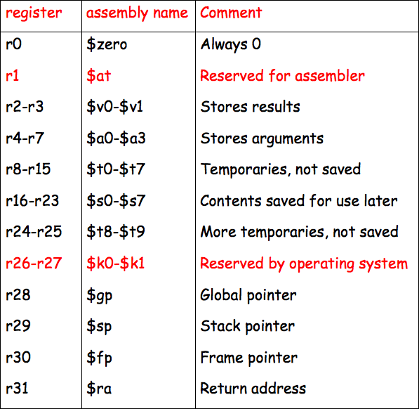
MIP Registers
http://homepage.cs.uiowa.edu/~ghosh/01-23-07.pdf
Fig. 1.4 in textbook (5th edition)
Notes:
We will use MIPS32/MIPS64 ISA.

Slide 32
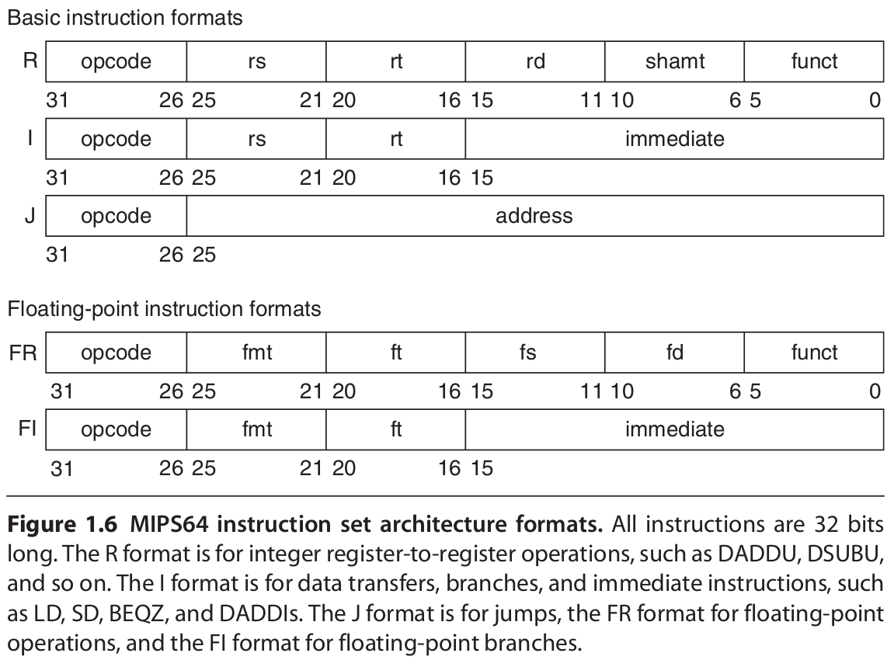
Encoding: MIPS64 ISA
Notes:
We will use MIPS32/MIPS64 ISA.
R-type: Register instructions
register-to-register operations such as arithmetic and logical functions where all operands are registers
I-type: Immediate instructions
16-bit immediate value are used for operations like arithmetic with constants, loading/storing memory, and branching
J-type: Jump instructions
used for control flow via jumps
FR: floating-point operations
FI: floating-point branches

Slide 33
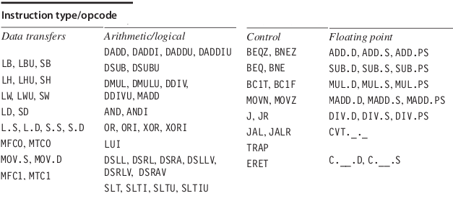
MIPS64 Instructions
Figure 1.5 Subset of the instructions in MIPS64. SP = single precision; DP = double precision. Appendix A gives much more detail on MIPS64. For data, the most significant bit number is 0; least is 63.
Notes:
We will use MIPS32/MIPS64 ISA.

Slide 34
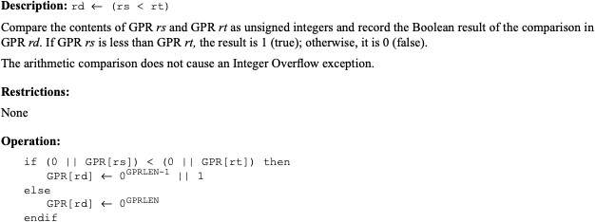
An example: SLTU
SLTU
Notes:
SLTU: Set on less than unsigned

Slide 35
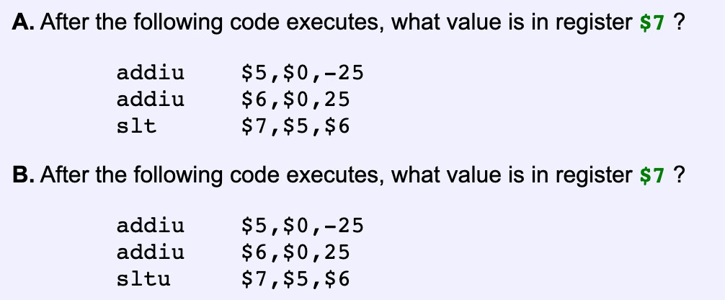
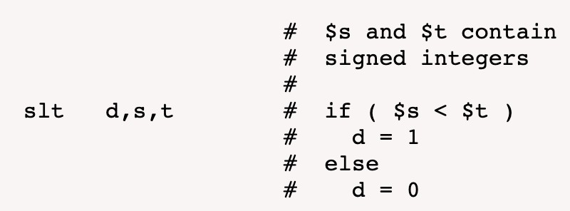
An example: SLTU
SLTU
Source: https://chortle.ccsu.edu/assemblytutorial/Chapter-18/ass18_4.html
Notes:
https://dannyqiu.me/mips-interpreter/
addiu $5, $0, -25
$5: -25 (0xffffffe7)
addiu $6, $0, 25
$6: 25 (0x00000019)
slt $7, $5, $6
$7: 1 (0x00000001)
sltu $7, $5, $6
$7: 0 (0x00000000)

Slide 36


Instruction Set Architecture
“... the attributes of a [computing] system as seen by the programmer, i.e. the conceptual structure and functional behavior, as distinct from the organization of the data flows and controls the logic design, and the physical implementation.”
– Amdahl, Blaauw, and Brooks, 1964
Organization of Programmable Storage
Data Types & Data Structures:
Encodings & Representations
Instruction Formats
Instruction (or Operation Code) Set
Modes of Addressing and Accessing
Data Items and Instructions
Exceptional Conditions
SOFTWARE

Slide 37
ISA vs. Computer Architecture
Old definition of computer architecture
= instruction set design
  Other aspects of computer design called implementation
  Insinuates implementation is uninteresting or
  less challenging
H&P’s view is computer architecture ≫ ISA
Architect’s job much more than instruction set design; technical hurdles today more challenging than those in instruction set design

Slide 38
Comp. Arch. is an Integrated Approach
What really matters is the functioning of the complete system
  hardware, runtime system, compiler, operating system, and application
  In networking, this is called the “End to End argument”
Computer architecture is not just about transistors, individual instructions, or particular implementations
  For example, original RISC projects
  replaced complex instructions with:
  a compiler + simple instructions

Slide 39
Comp. Arch. is an Integrated Approach
Determine what attributes are
important for a new computer
Design a computer to maximize
  Performance
  Energy efficiency
While staying within
  Cost
  Power
  Availability constraints.

Slide 40
Trends in Technology

Slide 41

Trends in Technology
2017 view
Integrated circuit technology (Moore’s Law)
  Transistor density: 35%/year
  Die size: 10-20%/year
  Integration overall: 40-55%/year
DRAM capacity: 25-40%/year (slowing)
  8 Gb (2014), 16 Gb (2019), possibly no 32 Gb
Flash capacity: 50-60%/year
  8-10X cheaper/bit than DRAM
Magnetic disk capacity: recently slowed to 5%/year
  Density increases may no longer be possible, maybe increase from 7 to 9 platters
  8-10X cheaper/bit then Flash
  200-300X cheaper/bit than DRAM
Network technology
  Depends both on the performance of switches and transmission systems
Trends in Technology
Notes:
1.4
An ISA must be designed to survive rapid changes in computer technology
By being aware of rapid changes in implementation technology,
A designer can plan for technology changes that can increase the lifetime of a successful computer
Five implementation technologies are critical to modern implementations:
Integrated circuit logic technology
Dynamic random-access memory
Semiconductor Flash
Magnetic disk technology
Network technology

Slide 42
Bandwidth and Latency
Bandwidth or throughput
  Total work done in a given time
  32,000-40,000X improvement for processors
  300-1200X improvement for memory and disks
Latency or response time
  Time between start and completion of an event
  50-90X improvement for processors
  6-8X improvement for memory and disks
Trends in Technology
Notes:
Bandwidth:
the total amount of work done in a given time
the maximum rate of data transfer across a given path
Latency:
the time between the start and the completion of an event
the delay before a transfer of data begins following an instruction for its transfer

Slide 43
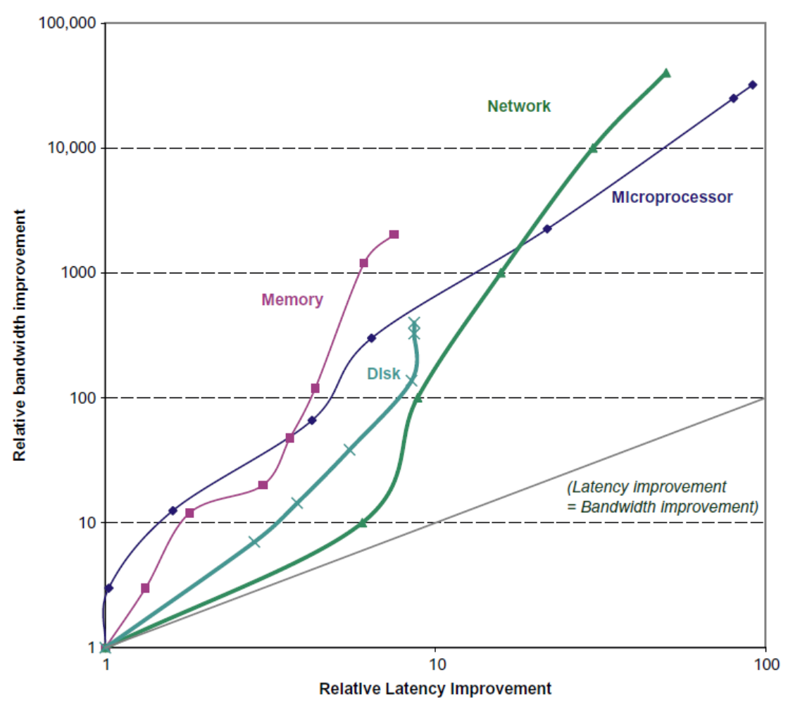
Bandwidth and Latency
Trends in Technology
Log-log plot of bandwidth and latency milestones
Notes:
Key insight:
Bandwidth has outpaced latency across these technologies and will likely continue to do so.
A simple rule of thumb is that bandwidth grows by at least the square of the improvement in latency.

Slide 44
Transistors and Wires
Feature size
  Minimum size of transistor or wire in x or y dimension
  10 microns in 1971 to .011 microns in 2017
  Transistor performance scales linearly
    Wire delay does not improve with feature size!
  Integration density scales quadratically
Trends in Technology

Slide 45
Power and Energy
Problem: Get power in, get power out
Thermal Design Power (TDP)
  Characterizes sustained power consumption
  Used as target for power supply and cooling system
  Lower than peak power (1.5X higher), higher than average power consumption
Clock rate can be reduced dynamically to limit power consumption
Energy per task is often a better measurement
Trends in Power and Energy
Notes:
1.5

Slide 46
Dynamic Energy and Power
Dynamic energy
  Transistor switch from 0 -> 1 or 1 -> 0
  ½ x Capacitive load x Voltage²
Dynamic power
  ½ x Capacitive load x Voltage² x Frequency switched
Reducing clock rate reduces power, not energy
Trends in Power and Energy

Slide 47
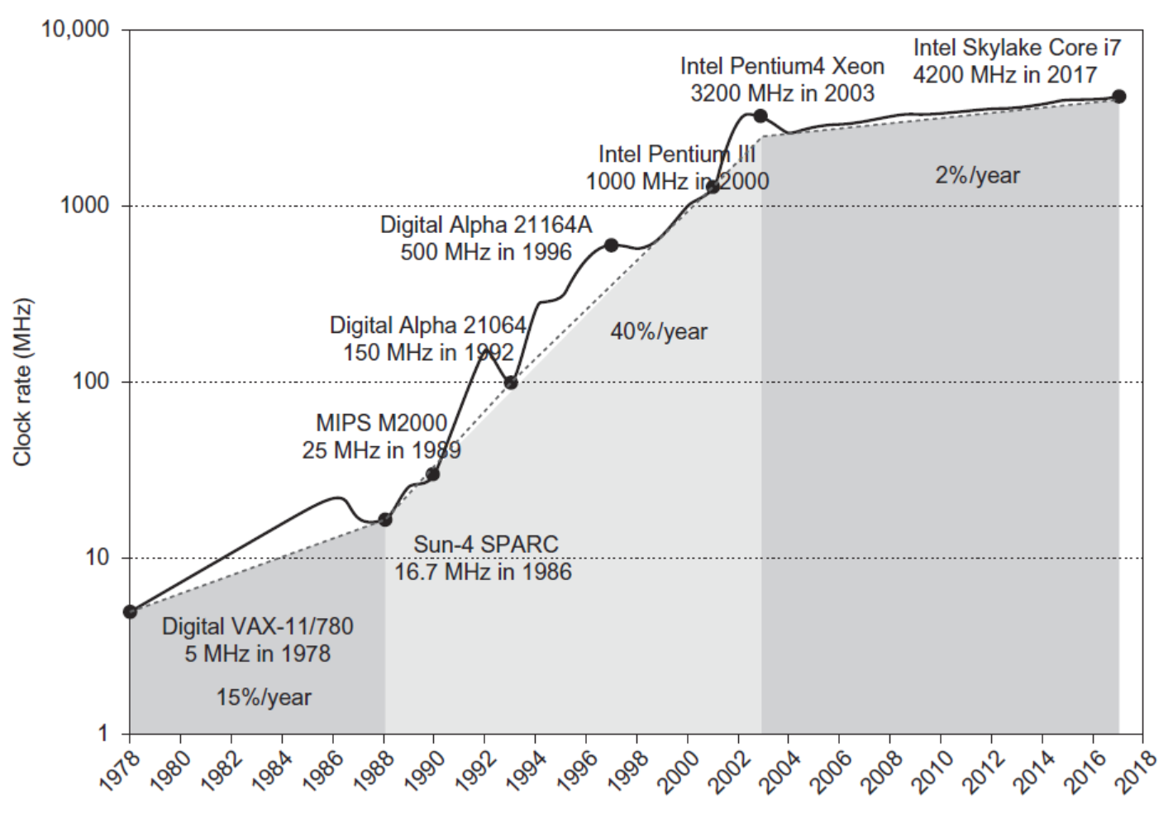
Clock Rate and Power
Intel 80386 consumed ~ 2 W
3.3 GHz Intel Core i7 consumes 130 W
Heat must be dissipated from 1.5 x 1.5 cm chip
This is the limit of what can be cooled by air
Trends in Power and Energy

Slide 48
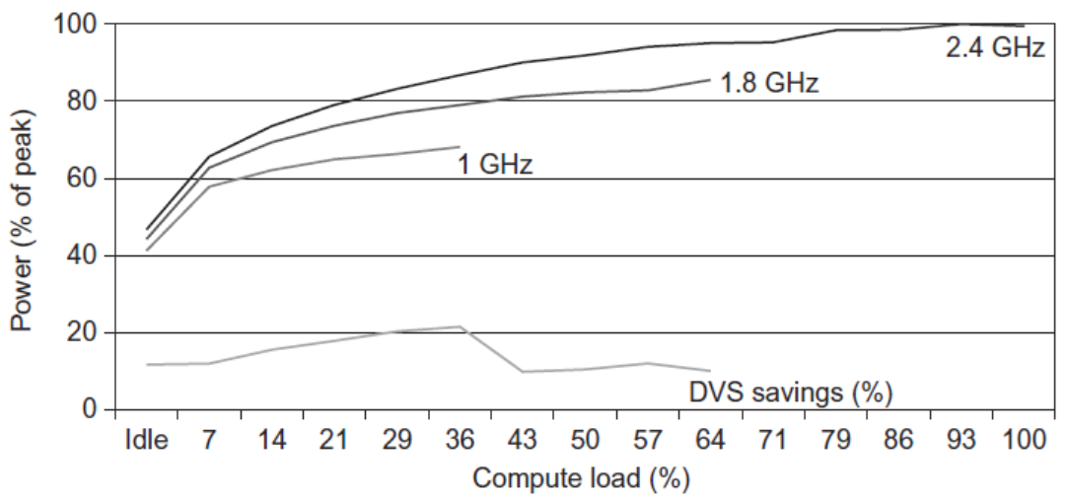
Reducing Power
Techniques for reducing power:
  Do nothing well
  Dynamic Voltage-Frequency Scaling
  Low power state for DRAM, disks
  Overclocking, turning off cores
Trends in Power and Energy

Slide 49
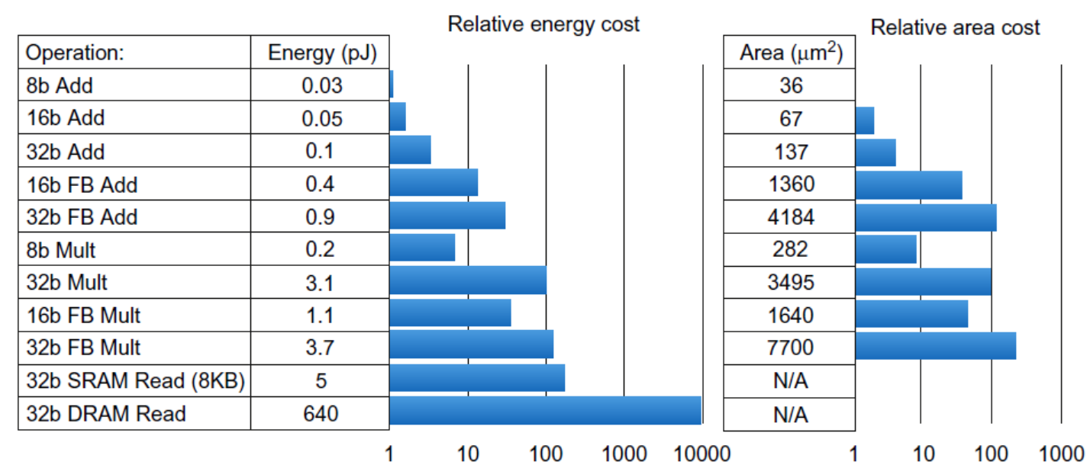
Static Power
Static power consumption
  25-50% of total power
  Current_{static} x Voltage
  Scales with number of transistors
  To reduce: power gating
Trends in Power and Energy

Slide 50
MANUFACTURING COSTS
10

Slide 51
Trends in Cost
Trends in Cost
Cost driven down by learning curve
  Yield
DRAM: price closely tracks cost
Microprocessors: price depends on volume
  10% less for each doubling of volume
Notes:
1.6
Major theme in the industry:
Lower costs while increasing performance
The underlying principle that drives costs down is
the learning curve manufacturing costs decrease over time, best measured by change in yield
Yield: the percentage of manufactured devices that survives the testing procedure
Understanding how the learning curve improves yield is critical to projecting costs over a product’s life.
DRAM:
Price per megabyte of DRAM has dropped over the long term
DRAM prices tend to track closely to manufacturing cost
Microprocessor prices also drop over time,
But price tends to track cost closely in a period of significant competition
Generally, price depends on volume in determining cost.
As a rule of thumb, some designers have estimated that
costs decrease about 10% for each doubling of volume.

Slide 52
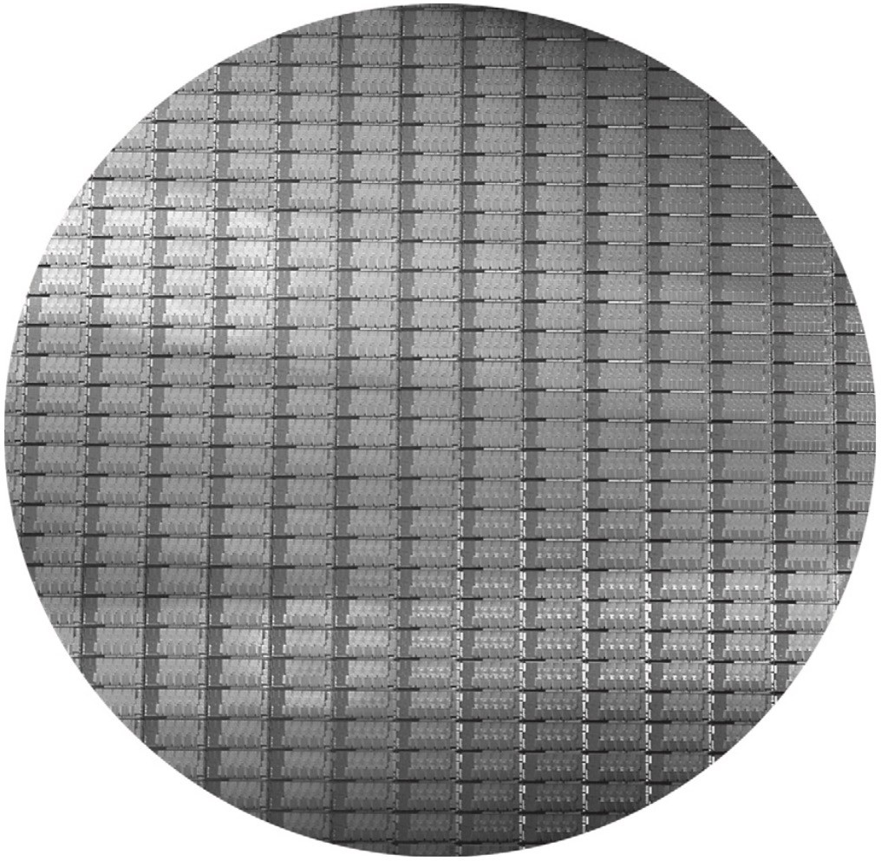
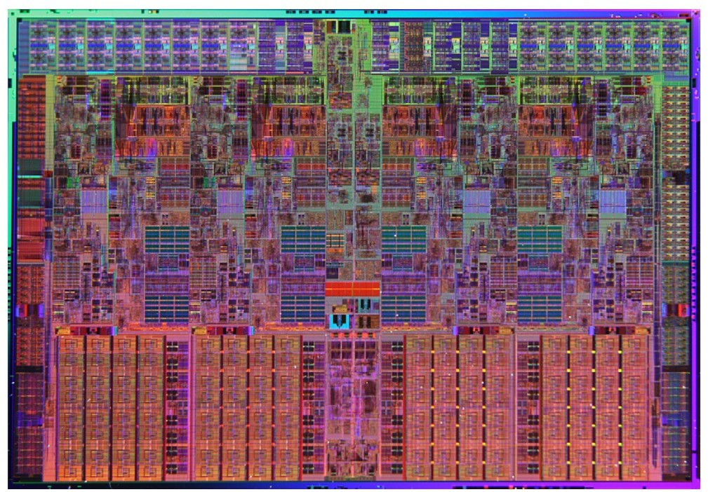
Manufacture of DRAM and other chips
Chips are manufactured on wafers - circular disks containing many dies (chips).
The wafer is tested and chopped into dies.
300 mm wafer ~
280 full Sandy Bridge dies, each 20.7x10.5mm
An Intel Core i7 Micro-processor die
18.9mm x 13.6mm (257mm²)
12
Notes:
How Crucial server memory (DRAM) is made
https://www.youtube.com/watch?v=pE6NuyMEey4

Slide 53
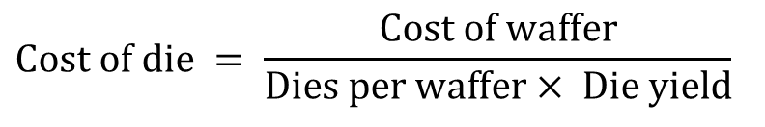
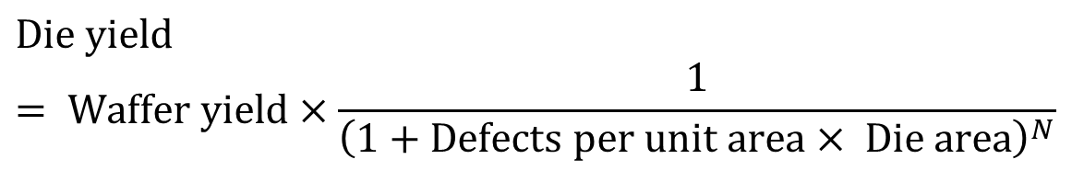
Wafers and Dies
To find the cost of a die:
  Number of dies per wafer is at most the area of the wafer divided by the area of the die.
  The cost of the wafer divided by the number of working dies per wafer is the cost of each die.
The fraction of working dies is called the die yield, which decreases as the area of the die increases.
$$\text{Cost} \text{of} \text{die} = \frac{\text{Cost} \text{of} \text{waffer}}{\text{Dies} \text{per} \text{waffer}× \text{Die} \text{yield}}$$
$$\text{Die} \text{yield} = \text{Waffer} \text{yield}×\frac{1}{{\left(1+\text{Defects} \text{per} \text{unit} \text{area}× \text{Die} \text{area}\right)}^{N}}$$

Slide 54

Integrated Circuit Cost
Trends in Cost
Integrated circuit
Bose-Einstein formula:
Defects per unit area = 0.016-0.057 defects per square cm (2010)
N = process-complexity factor = 11.5-15.5 (40 nm, 2010)

Slide 55
PERFORMANCE & MEASUREMENT

Slide 56
Dependability
What is decision criteria for “system operating properly”?
Infrastructure providers started to offer:
  Service Level Agreements (SLA) to guarantee how dependable their networking or power service will be.
Systems alternate between two states of service:
  Service accomplishment
  (working: service is delivered as specified in SLA)
  Service interruption
  (not working: delivered service is different from SLA)
Failure = transition from working to not working
Restoration = transition from not working to working
Notes:
>>
How do we decide when a system is operating properly.?
With the rise in internet services,
infrastructure providers started offering service level agreements (SLAs)
to guarantee that their networking or power service would be dependable.
Two states of service:
…

Slide 57
Dependability (cont.)
Module reliability
  Measure of continuous service accomplishment
  (or time to failure)
Mean Time To Failure (MTTF) measures reliability
Failures In Time (FIT) = 1 / MTTF, the failure rate
  Usually, reported as failures per billion hours of operation
Mean Time To Repair (MTTR) measures service interruption
Mean Time Between Failures (MTBF) = MTTF + MTTR

Slide 58
Dependability (cont.)
Module availability measures service as alternate between the two states of accomplishment and interruption (number between 0 and 1, e.g. 0.9)
Module availability
= MTTF / MTBF
= MTTF / (MTTF + MTTR)
If modules have exponentially distributed lifetimes (i.e., the age of a module does not affect its probability of failure), the overall failure rate (FIT) is the sum of failure rates of the modules

Slide 59
Dependability (cont.)
Example: Calculating reliability
– Calculate FIT (rate) and MTTF (1/rate) of a
disk subsystem that consists of:
» 10 disks (1M hour MTTF per disk)
» 1 ATA disk controller (0.5M hour MTTF)
» 1 power supply (0.2M hour MTTF)
» 1 fan, 0.2M hour MTTF
» 1 ATA cable, 1M hour MTTF
FailureRate
1 1 1 1 1
= 10 × + + + +
system
10⁶ 500, 000 200, 000 200, 000 10⁶
₌ 10 + 2 + 5 + 5 +1 ₌ 23
10⁶
10⁶
₌ 23, 000
i.e., 23, 000FIT
10⁹
1 10⁹
^{MTTF}system ⁼
=
≈ 43, 500 hours ≈ 5years
FIT 23, 000
Notes:
FIT
= 10 x 1/10^6 + 1/500,000 + 1/200,000 + 1/200,000 + 1/10^6
= (10 + 2 + 5 + 5 + 1) / 10^6 = 23 / 10^6
= 23,000 / 10^9 (23,000 FIT)
MTTF
= 1 / FIT
= 10^9 / 23,000
~ 43,500 hours or 5 years

Slide 60
Measuring Performance
Typical performance metrics:
  Response time
  Throughput
Speedup of X relative to Y
  Execution time_{Y} / Execution time_{X}
Execution time
  Wall clock time: includes all system overheads
  CPU time: only computation time
Benchmarks
  Kernels (e.g. matrix multiply)
  Toy programs (e.g. sorting)
  Synthetic benchmarks (e.g. Dhrystone)
  Benchmark suites (e.g. SPEC06fp, TPC-C)
Measuring Performance
Notes:
1.8

Slide 61
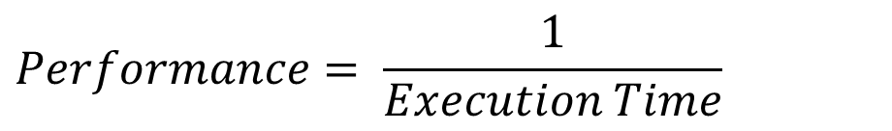
Comparing performance of two machines
Definition:
  Performance is the inverse of execution time
Problem: How to measure execution time?
$$Performance= \frac{1}{Execution Time}$$

Slide 62
What is time?
Unix time command example:
90.7u 12.9s 2:39 65%
  The user used the CPU for 90.7 seconds (user CPU time)
  The system used it for 12.9 seconds (system CPU time)
  Elapsed time (wall clock time) from the user's request
  to completion of the task was:
  2 minutes, 39 seconds (159 seconds)
  And (90.7 + 12.9) / 159 = 65%
» the rest of the time was spent waiting for I/O
or running other programs

Slide 63
What is time?
Unix time command example:
    real 2m39.000s
    user 1m30.700s
    sys 0m12.900s
The user used the CPU for 90.7 seconds (user CPU time)
  The system used it for 12.9 seconds (system CPU time)
  Real: Elapsed time (wall clock time) from the
  user's request to completion of the task was:
  2 minutes, 39 seconds (159 seconds)
  And (90.7 + 12.9) / 159 = 65%
    » the rest of the time was spent waiting for I/O
    or running other programs

Slide 64
Time (cont.)
Usual measurements of time:
  System performance measures the wall clock time on unloaded (single user) system
  CPU performance measures user CPU time on unloaded system

Slide 65
Reproducibility
Benchmarking is a laboratory experiment, and needs to be documented as fully as a well-run chemistry experiment
  Identify each variable hardware component
  Identify compiler flags and measure variability
  Verify reproducibility and provide data for others to reproduce the benchmarking results

Slide 66
Reporting results
Example of performance for SPEC benchmark is in H&P Figure 1.17 (5th) and Figure 1.19 (6th)
Fig 1.17 for Sun Ultra5, AMD Opteron, Intel Itanium 2
Fig 1.19 for Sun Ultra Enterprise 2, AMD A10, and Intel Xeon E5-2690
Need to look on SPEC web site for all the parameters of
the machines, including
» data on hardware – CPU (how many, primary and
secondary caches), memory, disk
» data on software – OS, compilers, file system type,
and compiler flags used (very important!)
How to summarize results?
Notes:
>>
SPEC (Standard Performance Evaluation Corporation)
uses these ratios and a geometric mean to
provide a single performance number for a suite of benchmarks,
enabling standardized comparison of different computer systems.

Slide 67
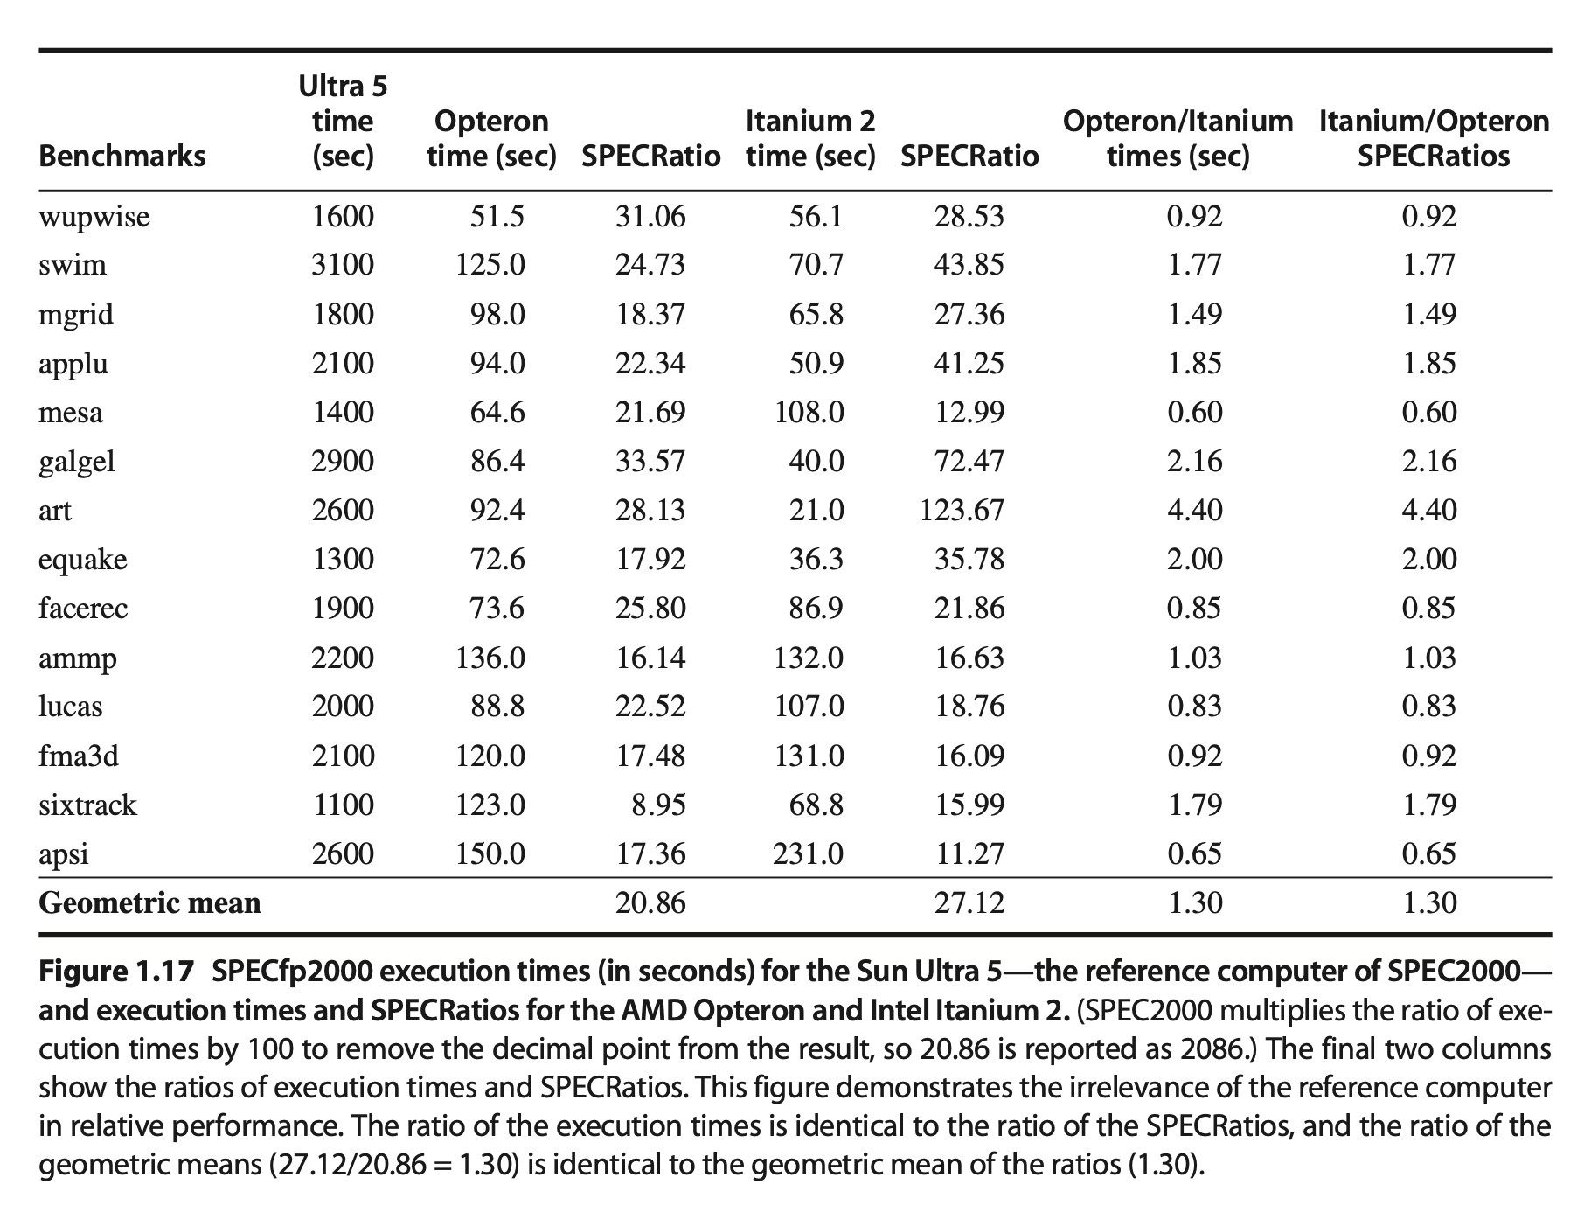
12
(from 5th ed)

Slide 68
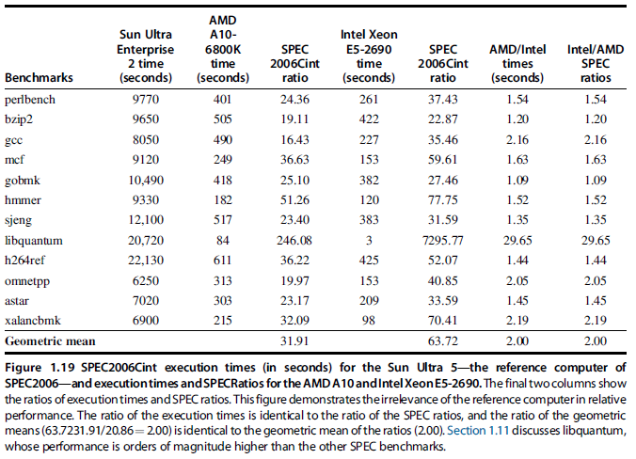

Slide 69
Statistical reporting
“It is rare indeed when advertisers, politicians, pop economists, and drumbeaters for medical programs offer a statistical argument that is not either misleading or downright deceptive.” - Martin Gardner
“... in mathematics you don't understand things, you just get used to them.” - John von Neumann
“... if you torture your data long enough, they will tell you what you want to hear.” - James L. Mills, M.D.

Slide 70
Statistical reporting (cont.)
The average execution time is the arithmetic mean:
sum the execution times for each program
and divide by the number of programs n
The harmonic mean is n divided by the sum of some function of each execution time
Often, both of these means are modified to give more weight to more important programs

Slide 71
Statistical reporting (cont.)
Arithmetic mean is good if the weights represent your own workload - then you can compare how each machine will perform for you
Should not set the weights based on performance on any particular machine; can get confusing results by doing that
Harmonic mean gives same sort of information, but is used when rates (e.g., instructions per second) are measured instead of times
Notes:
Harmonic mean = n / instructions per second

Slide 72

Geometric mean
To measure relative performance,
the geometric mean can be used
Choose a reference machine, divide all execution times by the corresponding times on the reference machine, multiply those ratios together, and take the n-th root of the product
Geometric means have the nice property
that you get consistent results (relative performance) regardless of which machine
is used to normalize (H&P 5th Figure 1.17)

Slide 73
SPEC Ratio
SPECRatio
Normalize execution times to reference computer, yielding a ratio proportional to performance
Time on slow reference computer Time on faster computer being rated
Notes:
>>
SPEC ratio is a performance metric calculated by
dividing the execution time of a benchmark on a reference machine
by its execution time on an examined system.

Slide 74
SPEC Ratio (cont.)
If a program’s SPECRatio on Computer A is
1.25 times bigger than Computer B, then
ExecutionTime_{reference}
_{1.25 =} SPECRatio_{A}
ExecutionTime_{A}
ExecutionTime_{reference}
=
SPECRatio_{B}
ExecutionTime_{B}
₌ ExecutionTime_{B =} Performance_{A}
ExecutionTime_{A} Performance_{B}
Note that when comparing 2 computers as a ratio, execution times on the reference computer drop out, so the choice of reference computer is irrelevant

Slide 75
SPEC Ratio (cont.)
For performance ratios, use the geometric mean
n
GeometricMean = n ∏SPECRatio_{i}
i=1
n
n ∏ SPECRatio_{Ai}
n
SPECRatio
n
∏
i=1
A
i
=
i=1
SPECRatio_{B}
n
i
n ∏ SPECRatio
i=1
B_{i}
The ratio of geometric means of SPEC Ratio is equal to the geometric mean of performance ratios
n
^{ExecTime}reference
n ∏SPECRatio
i
GeometricMean
A_{i}
n
SPECRatio
n
ExecTime
n
Performance
A
GeometricMean_{B}
=
i=1
= n
∏
A
i
=
n ∏
i=1
A
i
= n
∏
i=1
A
i
n
_{i=1} SPECRatio_{B}
^{ExecTime}reference
Performance_{B}
n
∏
i=1
SPECRatio
i
i
i
B_{i}
ExecTime_{B}
i

Slide 76
SPEC Ratio (cont.)
The ratio of geometric means of SPEC Ratio is equal to the geometric mean of performance ratios
The choice of reference computer is irrelevant
  These two points make geometric mean of ratios attractive to summarize performance
  Key Question: Does a single mean well summarize performance of programs in benchmark suite?
    Can answer the question, if we characterize the variability of distribution using standard deviation
    Take the logarithm of SPECRatios,
    compute the standard mean and standard deviation,
    and then take the exponent to convert back

Slide 77
Principles of Computer Design
Principles
Take Advantage of Parallelism
  e.g. multiple processors, disks, memory banks, pipelining, multiple functional units
Principle of Locality
  Reuse of data and instructions
Focus on the Common Case
  Amdahl’s Law
Notes:
1.9
Amdahl's law
describes the theoretical maximum speedup of a task when a portion of the task is enhanced (e.g. parallelized)

Slide 78
How to make computers faster?
Make the common cases faster!
Example:
Put more effort and funds into optimizing the hardware for addition than to optimize square root
Amdahl's law quantifies this principle:
Define speedup as the time the task took originally divided by the time the task takes after improvement

Slide 79
Amdahl’s Law
Then Amdahl's Law tells us what the speedup of a particular task is, given
  Fraction f of the original execution time
  that the task could use the improvement
  The speedup factor s of a task that always uses the improvement
Then what is the speedup of the task?

Slide 80
Amdahl’s Law (cont.)
Suppose that the original task runs for 1 second
f represents the time spent in the critical piece,
and 1 - f in other things
Then the task on the improved machine will take only
f / s seconds in the critical piece, but will still take 1 - f seconds in other things
old Time ₌
1
speedup =
new Time
(1− f ) + ^{f}
s

Slide 81

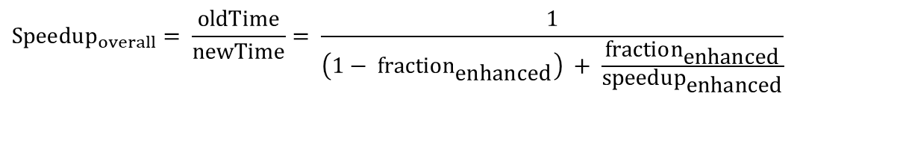
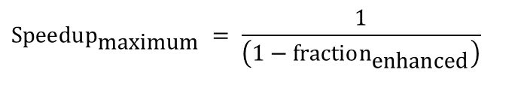
Amdahl’s Law (from the book)
$$\text{newTime}= \text{oldTime} \text{x} \left[\left(1− \text{fractio}{\text{n}}_{\text{enhanced}}\right) + \frac{\text{fractio}{\text{n}}_{\text{enhanced}}}{\text{speedu}{\text{p}}_{\text{enhanced}}}\right]$$
$$\text{Speedu}{\text{p}}_{overall}= \frac{\text{oldTime}}{\text{newTime}}= \frac{1}{\left(1− \text{fractio}{\text{n}}_{\text{enhanced}}\right) + \frac{\text{fractio}{\text{n}}_{\text{enhanced}}}{\text{speedu}{\text{p}}_{\text{enhanced}}}}$$
Best you could ever hope to do:
$$\text{Speedu}{\text{p}}_{\text{maximum}} = \frac{1}{\left(\text{1 − }\text{fractio}{\text{n}}_{\text{enhanced}}\right)}$$

Slide 82
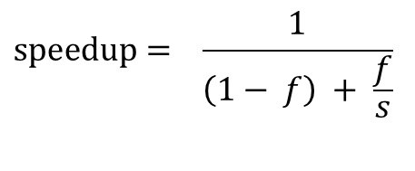
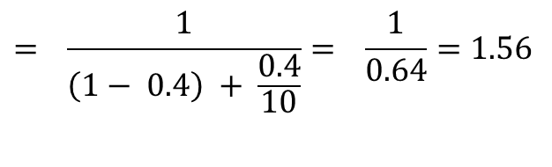
Amdahl’s Law example
New CPU 10X faster
I/O bound server, so 60% time waiting for I/O
Apparently, its human nature to be attracted by 10X faster, vs. keeping in perspective its just 1.6X faster
$$\text{speedup}= \frac{1}{\left(1− f\right) + \frac{f}{s}}$$
$$= \frac{1}{\left(1−\text{ 0.4}\right) + \frac{\text{0.4}}{\text{10}}}= \frac{1}{0.64}=1.56$$
Notes:
Speedup = 1 / [(1 – 0.4) + (0.4 / 10)] = 1 / 0.64 = 1.56

Slide 83
Review Question 1 (Speedup)
Suppose we work very hard improving the square root hardware, and that our task originally spends 1% of its time doing square roots. Even if the improvement reduces the square root time to zero, the speedup is no better than:
speedup = ?
old Time
1
=
new Time
(1− f ) + ^{f}
s

Slide 84
Review Question 1 (Speedup)
Suppose we work very hard improving the square root hardware, and that our task originally spends 1% of its time doing square roots. Even if the improvement reduces the square root time to zero, the speedup is no better than:
speedup =
And we might be better off putting our effort
into a more important part of the task
1
1
=
=
1.01
1 − f
.99

Slide 85
Review Question 2
Suppose we get the speedup of 2 after we replace the GPU card installed on a system with a new one. If the new card can process every GPU instruction 5 times faster, what is the percentage of instructions affected by the new GPU?
  [0%, 30%)
  [30%,50%)
  [50%,70%)
  [70%,90%)
  [90%,100%)
  100%
Notes:
Speedup = 2
Speedup factor = 5
2 = 1 / [(1- f) + (f / 5)]
2 * [(1 – f) + (f / 5)] = 1
2 – 2f + 2f/5 = 1
1 = 2f – 2f/5
1 = f * (8/5)
f = 5/8 = 62.5%
So, the answer is C.

Slide 86
Review Question 3 (Speedup)
Suppose that, for the same cost, we can speed up integer arithmetic by a factor of 20 or speed up floating point arithmetic by a factor of 2. If our task spends 10% of its time in integer arithmetic, and 40% of its time in floating point arithmetic, which should we do?
Option 1:
1
speedup = = 1.105
.9 + ^{.1}
20
Option 2:
1
speedup =
= 1.25
.6 + ^{.4}
2
Notes:
Option 1:
Speedup = 1 / (0.9 + 0.1 / 20) = 1.105
Option 2:
Speedup – 1 / (0.6 + 0.4 / 2) = 1.25

Slide 87
The Processor Performance Equation

Slide 88
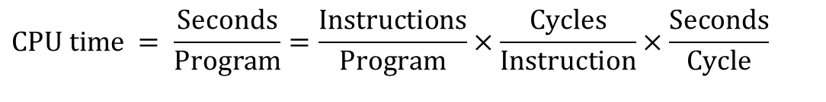
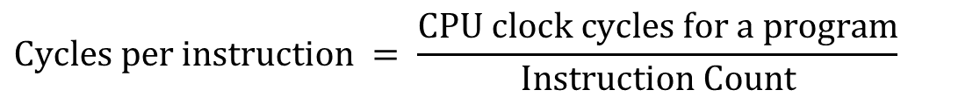
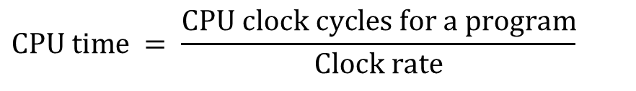
Principles of Computer Design
Principles
The Processor Performance Equation
$$\text{CPU} \text{time} = \text{CPU} \text{clock} \text{cycles} \text{for} \text{a} \text{program} × \text{Clock} \text{cycle} \text{time}$$
$$\text{CPU} \text{time} = \frac{\text{CPU} \text{clock} \text{cycles} \text{for} \text{a} \text{program}}{\text{Clock} \text{rate}}$$
$$\text{Cycles} \text{per} \text{instruction} = \frac{\text{CPU} \text{clock} \text{cycles} \text{for} \text{a} \text{program}}{\text{Instruction} \text{Count}}$$
$$\text{CPU} \text{time} = \text{Instruction} \text{count} ×\text{Cycles} \text{per} \text{instruction} × \text{Clock} \text{cycle} \text{time}$$
$$\text{CPU} \text{time} = \frac{\text{Seconds}}{\text{Program}}=\frac{\text{Instructions}}{\text{Program}}×\frac{\text{Cycles}}{\text{Instruction}}×\frac{\text{Seconds}}{\text{Cycle}}$$

Slide 89
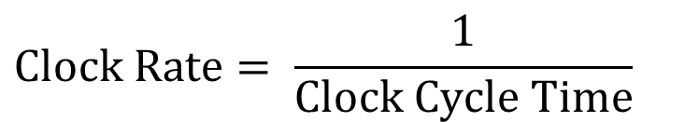
CPU Performance
Clock cycle: basic unit of time in a CPU
  Something new happens in a computer during every clock cycle
  Clock cycle time (CCT) (or clock period)
Clock rate: the rate at which a CPU executes instructions
  Measured in Hertz (cycles per second)
  The clock rate is what manufacturers usually advertise to indicate a chip's speed
  e.g., a 3.3GHz Intel Core-i9 (2017)
$$\text{Clock} \text{Rate}= \frac{\text{1}}{\text{Clock} Cycle Time}$$
Notes:
Clock cycle:
Is the basic unit of time in a computer's central processing unit (CPU)
Clock cycle time: (or clock period)
Is the time interval between consecutive rising edges of a repetitive clock signal in a digital system
Clock rate: (also known as clock speed or clock frequency)
Is the rate at which a computer's central processing unit (CPU) executes instructions
Clock rate:
3.3GHz = 3.3 x 10^9 cycles per second
Clock cycle time:
1 / 3.3GHz
= (1 / 3.3 x 10^9) seconds per cycle
= (10^-9 / 3.3) seconds
= (1 / 3.3) nanoseconds
~= 0.303 ns
1.1GHz:
1 / 1.1GHz
= 1 / 1.1 ns
~= 0.909 ns

Slide 90
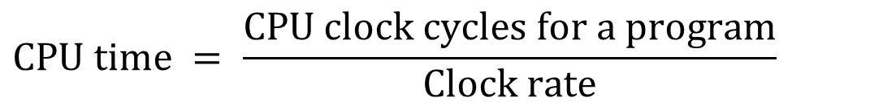
CPU Performance (cont.)
Principles
CPU time (or process time): amount of time that a CPU was used for processing instructions of a computer program
$$\text{CPU} \text{time} = \text{CPU} \text{clock} \text{cycles}× \text{Clock} \text{cycle} \text{time}$$
$$\text{CPU} \text{time} = \frac{\text{CPU} \text{clock} \text{cycles} \text{for} \text{a} \text{program}}{\text{Clock} \text{rate}}$$
Notes:
CPU time: (or process time)
Is the amount of time that a CPU was used for processing instructions of a computer program

Slide 91
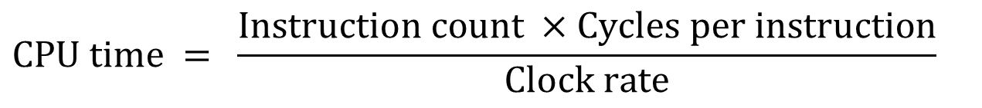
CPU Performance (cont.)
But how fast the machine can execute a program also depends on the number of clock cycles per instruction (CPI)
Total CPU time = instruction count (IC) times CPI divided by clock rate (MHz/GHz)
– IC * CPI / GHz
Note: CPI is not a good measure of performance all by itself since it varies by type of instruction!
$$\text{CPU} \text{time} = \frac{\text{Instruction} \text{count} ×\text{Cycles} \text{per} \text{instruction}}{\text{Clock} \text{rate}}$$
Notes:
Clock cycle:
Is the basic unit of time in a computer's central processing unit (CPU)
Clock cycle time: (or clock period)
Is the time interval between consecutive rising edges of a repetitive clock signal in a digital system

Slide 92
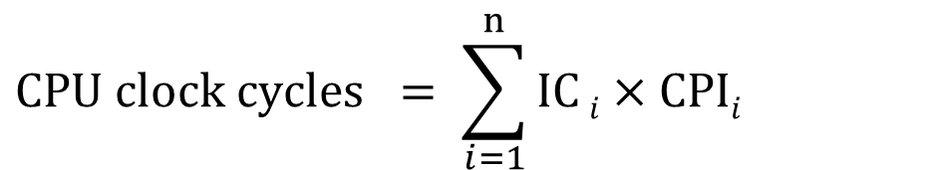
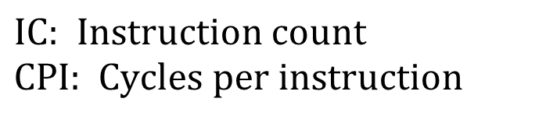
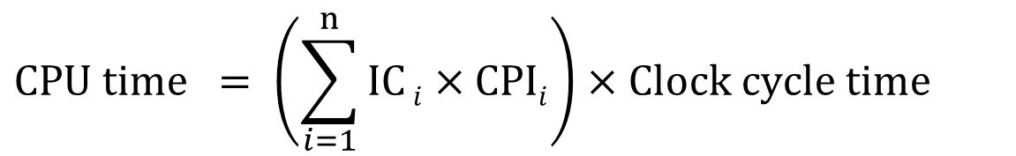
CPU Performance (cont.)
Principles
Different instruction types having different CPIs
$$\text{IC}\text{: }\text{Instruction} \text{count} \\ \text{CPI}\text{: }\text{Cycles} \text{per} \text{instruction}$$
$$\text{CPU} \text{clock} \text{cycles} = \sum_{i=1}^{n}{\text{IC}}i×\text{CPI}i$$
$$\text{CPU} \text{time} = \left(\sum_{i=1}^{n}{\text{IC}}i×\text{CPI}i\right)×\text{Clock} \text{cycle} \text{time}$$

Slide 93
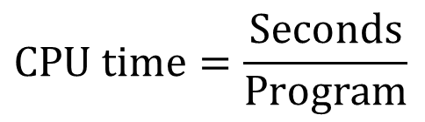
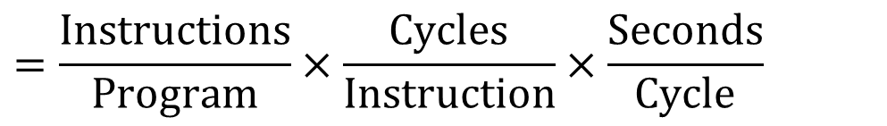
CPU Performance (cont.)
Principles
CPU time (or process time): amount of time that a CPU was used for processing instructions of a computer program
$$\text{CPU} \text{time}=\frac{\text{Seconds}}{\text{Program}}$$
$$=\frac{\text{Instructions}}{\text{Program}}×\frac{\text{Cycles}}{\text{Instruction}}×\frac{\text{Seconds}}{\text{Cycle}}$$

Slide 94
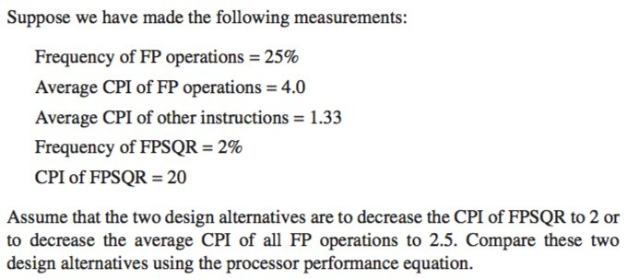
CPU Performance Example
An example that illustrates the overall effect

Slide 95


CPU Performance Example (cont.)
Notes:
CPI_original
= (4 x 25%) + (1.33 x 75%) = 2.0
CPI_with_new_FPSQR
= 2.0 – 2% x (20 – 2) = 1.64
CPI_new_FP
= (75% x 1.33) + (25% x 2.5) = 1.625

Slide 96
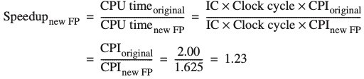
CPU Performance Example (cont.)

Slide 97
How to design a fast computer
Amdahl's law says put your effort into optimizing instructions that are often used.
The locality of reference rule-of-thumb says that a program spends 90% of its time in 10% of the code, so we should put effort into taking advantage of this, through a memory hierarchy
For data accesses, 2 types of locality
  Spatial
  Temporal

Slide 98
Take Advantage of Parallelism
At system level
  e.g., use multiple CPUs, disks
At processor level
  among instructions
  pipelining
At digital design level
  e.g., set associative caches,
  carry-lookahead in ALU design
Notes:
set-associative cache:
Is a computer memory cache that organizes data into sets,
where each set contains multiple cache lines (or blocks)
Carry-lookahead:
Is a technique for speeding up adders within an ALU by pre-calculating carry bits in parallel
ALU: Arithmetic Logic Unit

Slide 99
Trends in Technology
(Revisited)

Slide 100
Bandwidth and Latency
Trends in Technology
Bandwidth or throughput
  Total work done in a given time
  Maximum rate of data transfer across a given path
  Focuses on data volume
Latency or response time
  Time between start and completion of an event
  Delay before a transfer of data begins following
  an instruction for its transfer
  Emphasizes data speed and responsiveness
Notes:
Bandwidth:
the total amount of work done in a given time
the maximum rate of data transfer across a given path
Latency:
the time between the start and the completion of an event
the delay before a transfer of data begins following an instruction for its transfer

Slide 101
Bandwidth and Latency
Trends in Technology
Log-log plot of bandwidth and latency milestones
Notes:
Bandwidth improvements have consistently outpaced latency improvements
across various technologies like microprocessors, memory, networks, and disks over the past several decades.

Slide 102
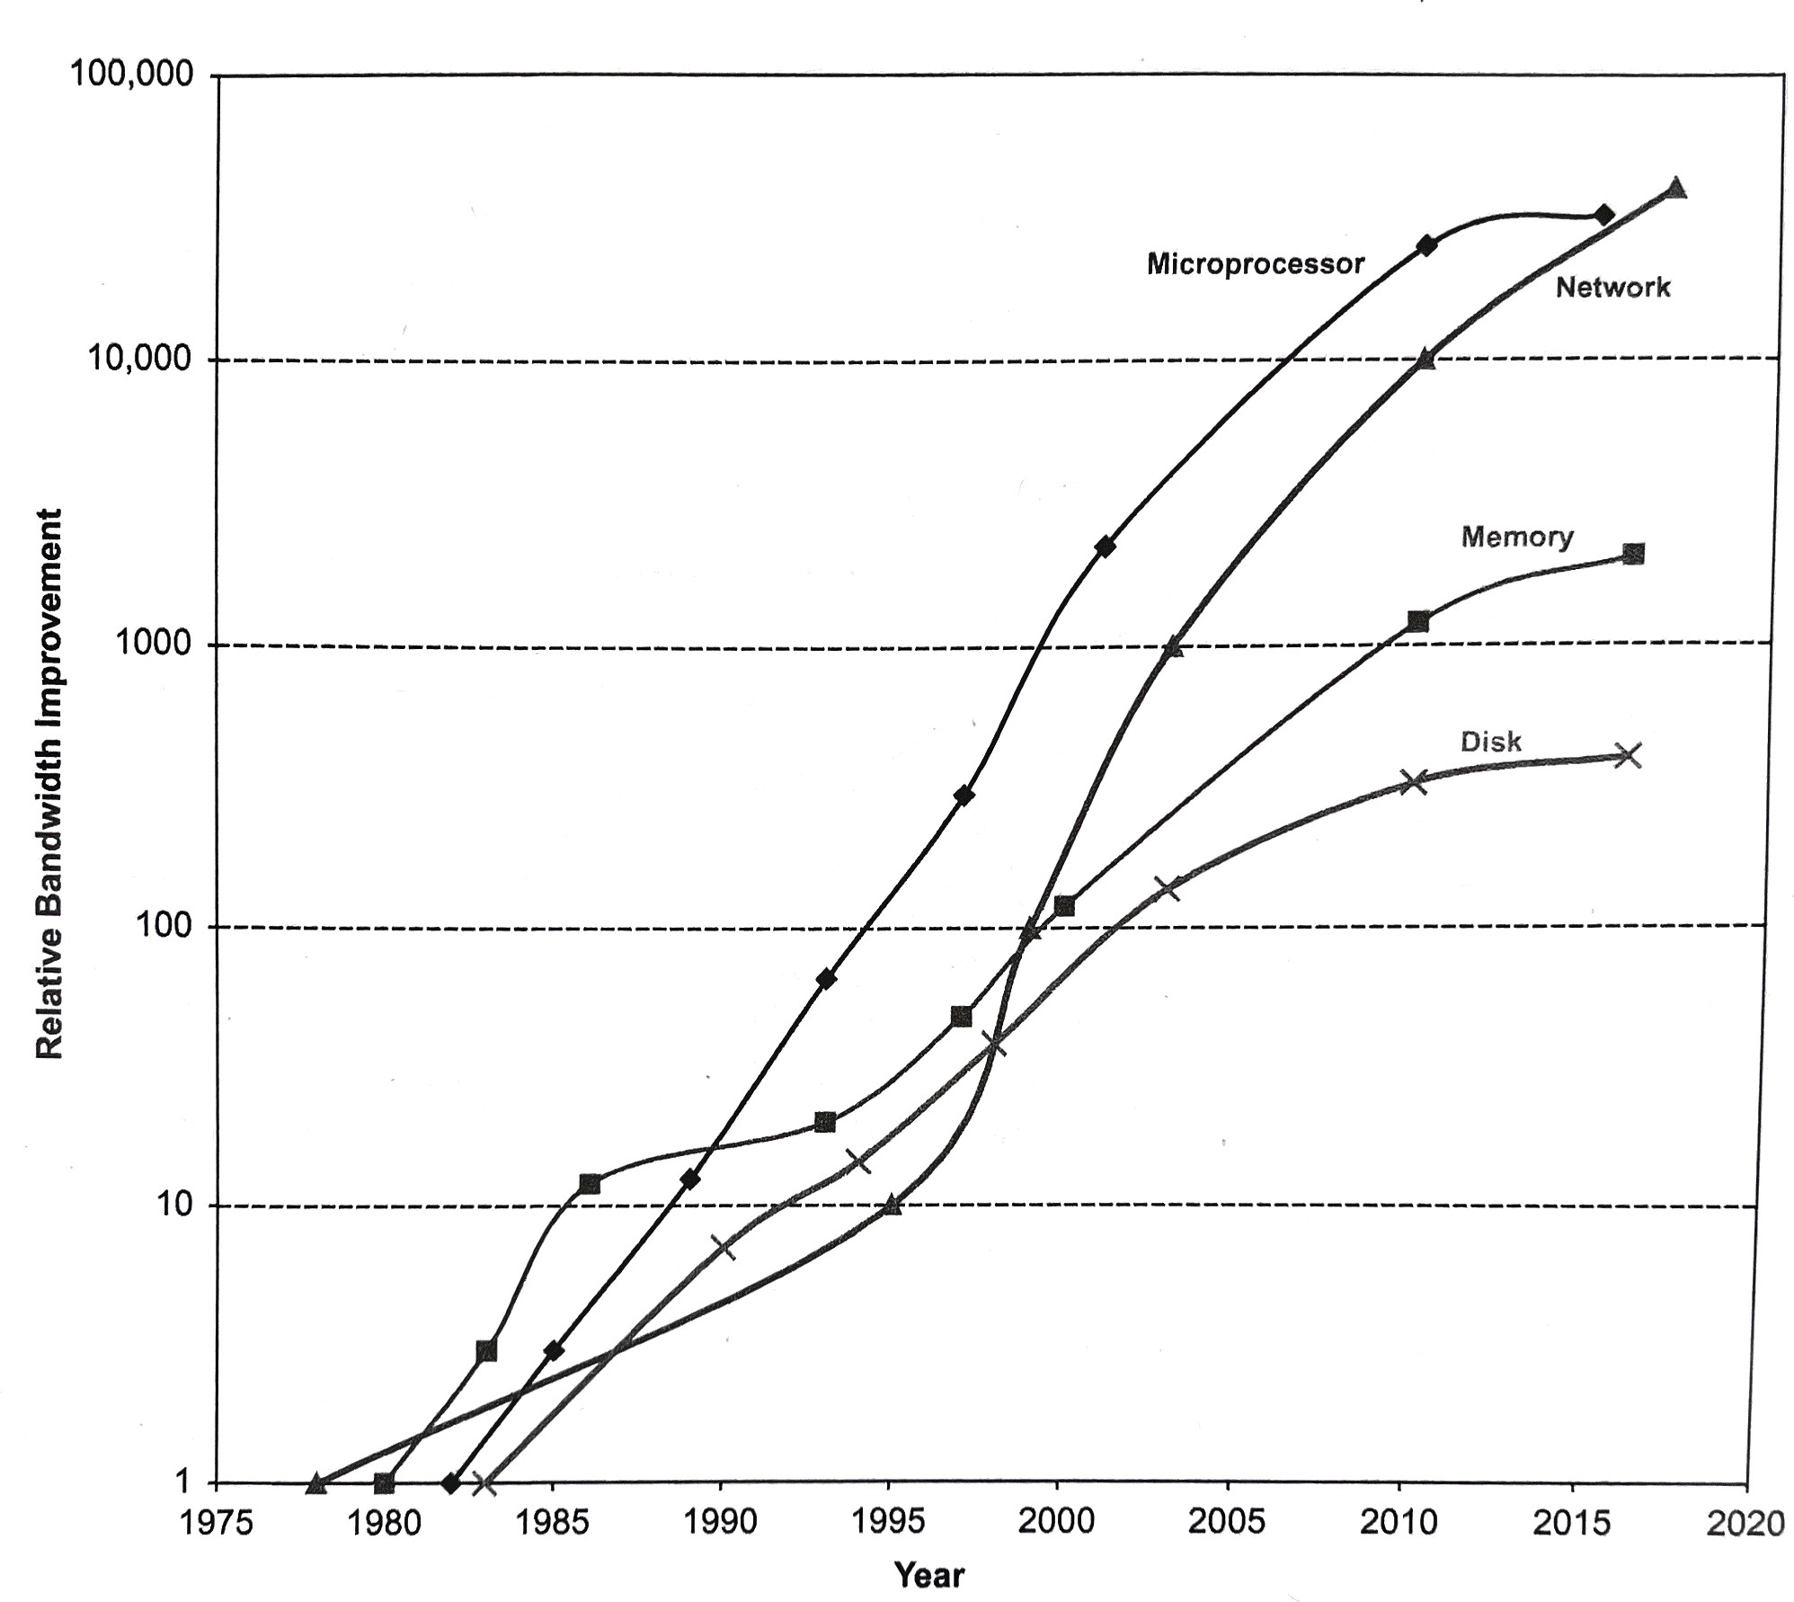
Bandwidth Improvement
6th ed. Fig. 1.23
Plot of bandwidth improvement over years
Notes:
Bandwidth improvements have consistently outpaced latency improvements
across various technologies like microprocessors, memory, networks, and disks over the past several decades.

Slide 103
Latency Lags Bandwidth
Rule of Thumb for Latency Lagging Bandwidth
  In the time that bandwidth doubles, latency improves by no more than a factor of 1.2 to 1.4 (and capacity improves faster than bandwidth)
  Stated alternatively:
  Bandwidth improves by more than the square of the improvement in Latency
Source: Communications of the ACM, October 2004 / Vol.47, No. 10
Notes:
This trend is captured by a rule of thumb stating that
in the time it takes for bandwidth to double,
latency improves by only a factor of 1.2 to 1.4.
1.4^2 = 1.96 vs. 2.0 for bandwidth improvement

Slide 104
6 Reasons Latency Lags Bandwidth
Moore’s Law helps BW more than Latency
Faster transistors, more transistors,
more pins help Bandwidth
Smaller, faster transistors (also more pins) but communicating over (relatively) longer lines on larger chips: limits latency
» | CPU Transistors: | 0.130 | vs. | 1170 M xtors | (9000X)
» | DRAM Transistors: | 0.064 | vs. | 256 M xtors | (4000X)
» | CPU Pins: | 68 | vs. | 1366 pins | (20X)
» | DRAM Pins: | 16 | vs. | 134 pins | (8X)
» CPU Die Size: 47 vs. 240 mm² (ratio sqrt → 2X)
Notes:
This imbalance occurs because bandwidth benefits more directly from Moore's Law,
which drives faster transistors and more parallel processing,
while physical constraints like distance and the speed of light
impose fundamental limits on how much latency can be reduced
… characterized by:
Faster, smaller, more transistors and pins improves bandwidth
Larger chip size leads to longer lines in communication which limits latency

Slide 105
6 Reasons Latency Lags Bandwidth (cont’d)
Distance limits Latency
  Size of DRAM block →
  long bit and word lines →
  most of DRAM access time
  Speed of light and computers on network
  1. & 2. explains linear latency vs. square BW?
Notes:
The physical distance within a DRAM chip significantly limits latency,
as the size of the DRAM block results in long bit and word lines,
which contribute substantially to the overall access time.
The relationship between latency and bandwidth improvements is not symmetric
since technology improvements that reduce latency generally also improve bandwidth.
Increased capacitance slows down signal propagation, leading to longer access latencies.
However, improvements that increase bandwidth do not always reduce latency.
(e.g. increasing the linear density of bits per inch on a disk track)

Slide 106
6 Reasons Latency Lags Bandwidth (cont’d)
Bandwidth easier to sell (“bigger=better”)
  e.g., 10 Gbits/s Ethernet (“10 Gig”)
  vs. 10 msec latency Ethernet
  4400 MB/s DIMM (“PC4400”) vs. 50 ns latency
  Even if it is just marketing,
  customers are now trained
  Since bandwidth sells, more resources thrown at bandwidth, which further tips the balance
Notes:
A significant factor contributing to this imbalance is the marketing advantage of bandwidth.
It is generally easier to sell higher bandwidth than lower latency
because the benefits of increased data transfer capacity
are more intuitive and tangible to customers.
This ease of marketing leads to higher demand for bandwidth,
which in turn results in engineering resources being
disproportionately allocated to improving bandwidth.
This becomes a self reenforcing cycle that
drives bandwidth improvements at the expense of latency.

Slide 107
6 Reasons Latency Lags Bandwidth (cont’d)
Latency helps Bandwidth, but not vice versa
  Spinning disk faster improves both bandwidth and rotational latency
» 3600 RPM → 15000 RPM = 4.2X
» Average rotational latency: 8.3 ms → 2.0 ms
» Things being equal, also helps BW by 4.2X
  Lower DRAM latency →
  More access/second (higher bandwidth)
  Higher linear density helps disk Bandwidth
  (and capacity), but not disk Latency
» 9,550 BPI (bit per inch) → 533,000 BPI → 60X in BW
Notes:
The fundamental relationship is that improvements in
latency generally enhance bandwidth, but not the reverse.
Spinning a disk faster reduces rotational latency and bandwidth.

Slide 108
6 Reasons Latency Lags Bandwidth (cont’d)
Bandwidth hurts Latency
  Queues help Bandwidth, hurt Latency
  Adding chips to widen a memory module increases Bandwidth but higher fan-out on address lines may increase Latency
Notes:
Bandwidth can hurt latency
Queue buffers:
which help increase bandwidth by managing data flow,
inherently increase latency by causing data to wait in queues.
Algorithms designed to maximize bandwidth often create conditions where latency is high due to queuing.
Adding more chips:
to a memory module increases parallelism and therefore improves bandwidth,
but the higher fan-out on address lines can lead to increased signal delays,
thereby worsening latency.

Slide 109
6 Reasons Latency Lags Bandwidth (cont’d)
Operating System overhead hurts Latency more than Bandwidth
  Long messages amortize overhead;
  overhead bigger part of short messages
  It takes longer to create and to send a long message, which is needed instead of a short message to lessen
  Average cost per data byte of fixed size message overhead.
Notes:
The overhead associated with a general-purpose OS like Windows,
such as the time spent managing multiple processes and handling interrupts,
directly contributes to both variations in latency (causing unpredictable delays) and increased latency.
The overhead does not significantly impact the maximum data transfer capacity (bandwidth)
but severely affects the predictability and speed of individual operations,
thereby degrading latency performance.

Slide 110
Wrapping up…
Computer architecture at the crossroads
from sequential to parallel computing
  Salvation requires innovation in many fields, including computer architecture
  An architect must track & extrapolate technology
Bandwidth in disks, DRAM, networks, and processors improves by at least as much as the square of the improvement in latency
Notes:
The transition from sequential to parallel computing
marks a pivotal moment in computer architecture,
demanding innovation across multiple domains
to overcome inherent limitations.
This shift necessitates a focus on exploiting parallelism
as the primary driver for performance improvement.
Computer architects must now prioritize extracting and utilizing various forms of parallelism.
…
Rise of:
Domain-specific architectures (DSAs)
Hardware accelerators, (e.g. Tensor Processing Units or TPUs)
needed for optimized performance and energy efficiency in specific tasks

Slide 111
Wrapping up…
Quantify dependability
  Reliability (MTTF, MTBF, MTTR, and FIT),
  Availability ( MTTF / (MTTF + MTTR) )
Quantify and summarize performance
  SPECRatio,
  Arithmetic, Harmonic, and Geometric Mean
  Amdahl's Law
  The Processor Performance Equation

Slide 112
Fallacies and Pitfalls
All exponential laws must come to an end
  Dennard scaling (constant power density)
    Stopped by threshold voltage
  Disk capacity
    30-100% per year, reduced to 5% per year
  Moore’s Law
    Most visible with DRAM capacity
    ITRS disbanded
    Only four foundries left producing state-of-the-art logic chips
    11 nm, 3 nm might be the limit
Notes:
1.11
Dennard scaling ended 30 years after it was observed
not because transistors didn’t continue to get smaller but
because integrated circuit dependability limited how far current and voltage could drop.
…

Slide 113
Fallacies and Pitfalls
Fallacies - commonly held misconceptions
  When discussing a fallacy, authors try to give a counterexample.
Pitfalls - easily made mistakes.
  Often generalizations of principles true in limited context

Slide 114
Fallacies and Pitfalls
Microprocessors are a silver bullet
  Performance is now a programmer’s burden
Falling prey to Amdahl’s Law
A single point of failure
Hardware enhancements that increase performance also improve energy efficiency, or are at worst energy neutral
Benchmarks remain valid indefinitely
  Compiler optimizations target benchmarks
Notes:
…
"Falling prey to Amdahl's Law"
means experiencing the diminishing returns of parallel computing due to a program's inherently sequential portions.
Focusing exclusively on parallelization
Adding more hardware without optimizing code
Assuming a fixed workload
Single point of failure
dependability is no stronger than the weakest link in a chain

Slide 115
Fallacies and Pitfalls
Fallacy: Benchmarks remain valid indefinitely
  Once a benchmark becomes popular, there is tremendous pressure to improve performance by targeted optimizations or by aggressive interpretation of the rules for running the benchmark.
  70 benchmarks in the 5 SPEC releases to 2000. 70% dropped from the next release because no longer useful
Pitfall: A single point of failure
  Rule of thumb for fault tolerant systems: make sure that every component is redundant so that no single component failure can bring down the whole system (e.g., power supply)
Notes:
Single point of failure
dependability is no stronger than the weakest link in a chain

Slide 116
Fallacies and Pitfalls
The rated MTTF of disks is 1.2 million hours or almost 140 years, so disks practically never fail
  MTTF value from manufacturers assume regular replacement
Peak performance tracks observed performance
Fault detection can lower availability
  Not all operations are needed for correct execution
Notes:
…
Fault detection can lower availability.
This apparently ironic pitfall is because computer hardware has a fair amount of
state that may not always be critical to proper operation.

Slide 117
Fallacies and Pitfalls
Fallacy - Rated MTTF of disks is 1.2 million hours or 140 years, so disks practically never fail
  MTTF value from manufacturers assume regular replacement
  But disk lifetime is 5 years;
  So, replace a disk every 5 years;
  On average, 28 replacements (140 year),
  So “never” fail

Slide 118
Fallacies and Pitfalls
  A better unit: % that fail (1.2M MTTF = 833 FIT)
  Fail over lifetime: if had 1000 disks for 5 years
= 1000 * (5 * 365 * 24) * 833 / 10⁹ ≈ 37
= 3.7% (37 / 1000) fail over 5 year lifetime
» This is under pristine conditions
little vibration
narrow temperature range
no power failures

Slide 119
Fallacies and Pitfalls
  Real world: 3% to 6% of SCSI hard drives fail per year
» 3400 - 6800 FIT or 150,000 to 300,000 hour MTTF [Gray & van Ingen 05]
  3% to 7% of ATA drives fail per year
  (Advanced Tech Attachment)
» 3400 - 8000 FIT or 125,000 to 300,000 hour MTTF [Gray & van Ingen 05]

